Slide 1
The British royal family
The House of Windsor
Urszula Godela I A

Slide 2
The beginning

Slide 3
Background
In 1901, after the death of Queen Victoria, a branch of the House of Saxe-Coburg and Gotha replaced the House of Hanover on the English throne. In 1917, due to anti-German sentiment in England during World War I, the royal name was changed from the German-sounding Sachsen-Coburg and Gotha to the more English-sounding Windsor. Since then, five British monarchs have descended from the Windsor family: George V, Edward VIII, George VI, Elizabeth II and Charles III.

Slide 4
The list of the members
According to official Royal family website

Slide 5
Royal family members
Monarchs
Rest of the members
George V (1865 – 1936)
Edward VIII (1894 – 1972)
George VI (1895 – 1952)
Elizabeth II (1926 – 2022)
Charles III (1948 - )
Camilla, Queen Consort
William, Prince of Wales
Catherine, Princess of Wales
George of Wales
Charlotte of Wales
Louis of Wales
Andrew, Duke of York
Beatrice, Princess
Eugenie, Princess
Edward, Duke of Edinburgh
Sophie, Duchess of Edinburgh
Louise, Lady
James, Earl of Wessex
Ann, Princess Royal
Richard, Duke of Gloucester
Birgitte, Duchess of Gloucester
Edward, Duke of Kent
Katharine, Duchess of Kent
Michael of Kent, Prince
Marie Christine, Michael of Kent
Alexandra, Princess Oglivy
Harry, Duke of Sussex
Meghan, Duchess of Sussex
Archie of Sussex
Lillibet of Sussex

Slide 6
Monarchs

Slide 7
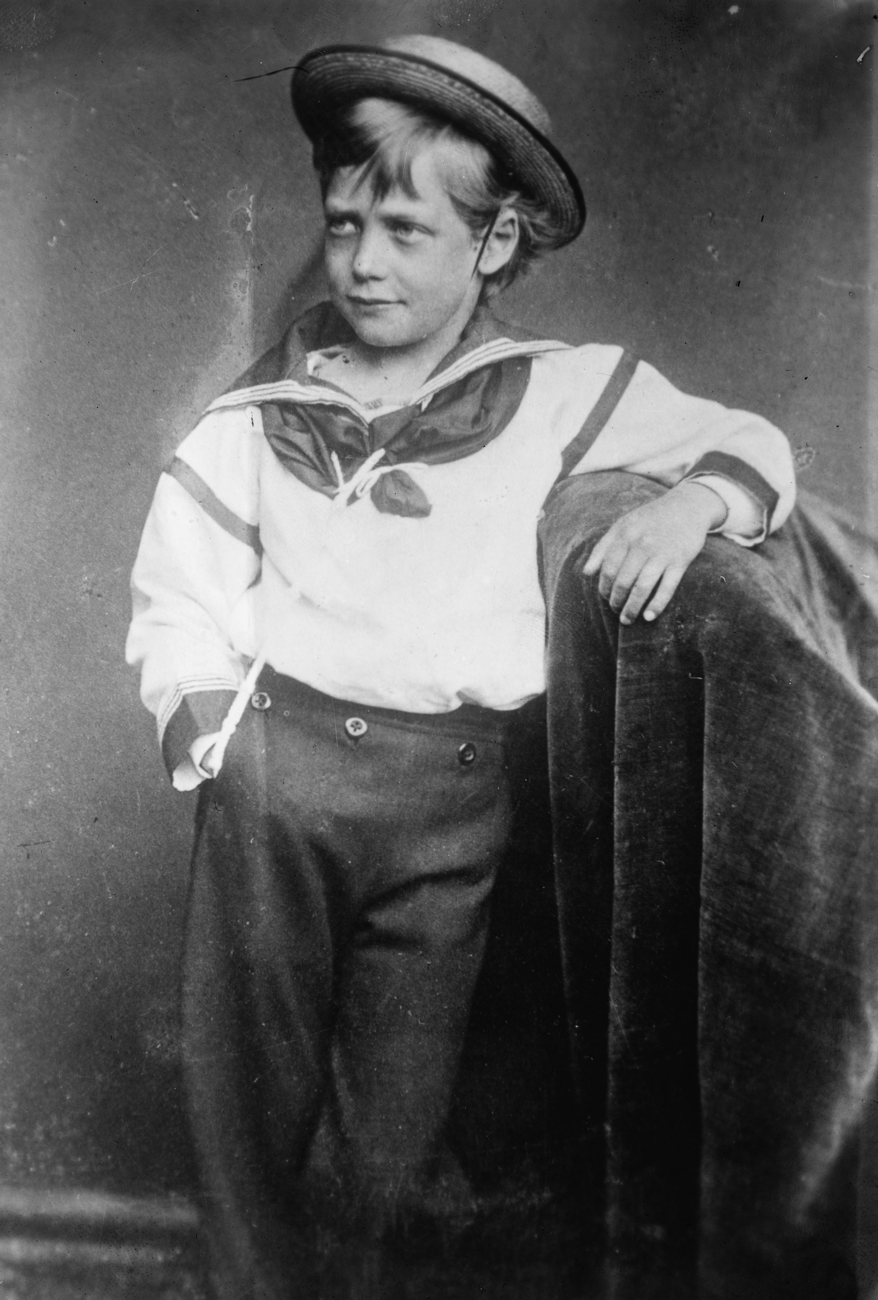
George V
George Frederick Ernest Albert was born on 3 June 1865, in Marlborough House, London.

Slide 8
George V
George was the second son of Albert Edward, Prince of Wales and the third in line to the British throne after his father and brother Prince Albert Victor. Queen Victoria was his grandmother. However, after the unexpected death of his older brother in 1892, he became the heir to the throne. In 1893 George married his brother's fiancé, Victoria Mary of Tech, with whom he had six children. When Queen Victoria died in 1901, George's father succeeded to the throne as Edward VII, and George was named the Prince of Wales. He became the king in 1910 after his father’s death.
The period of his reign was difficult and as a king he saw the rise of socialism, communism, fascism, Irish republicanism and the Indian independence movement. All these things radically changed the political climate of the British Empire, whose territorial peak was in the early 1920s. World War I (1914–1918) resulted in the collapse of the empires of his cousins ​​Nicholas II of Russia and Wilhelm II of Germany. Because of it the British Empire expanded to its most effective extent.

Slide 9
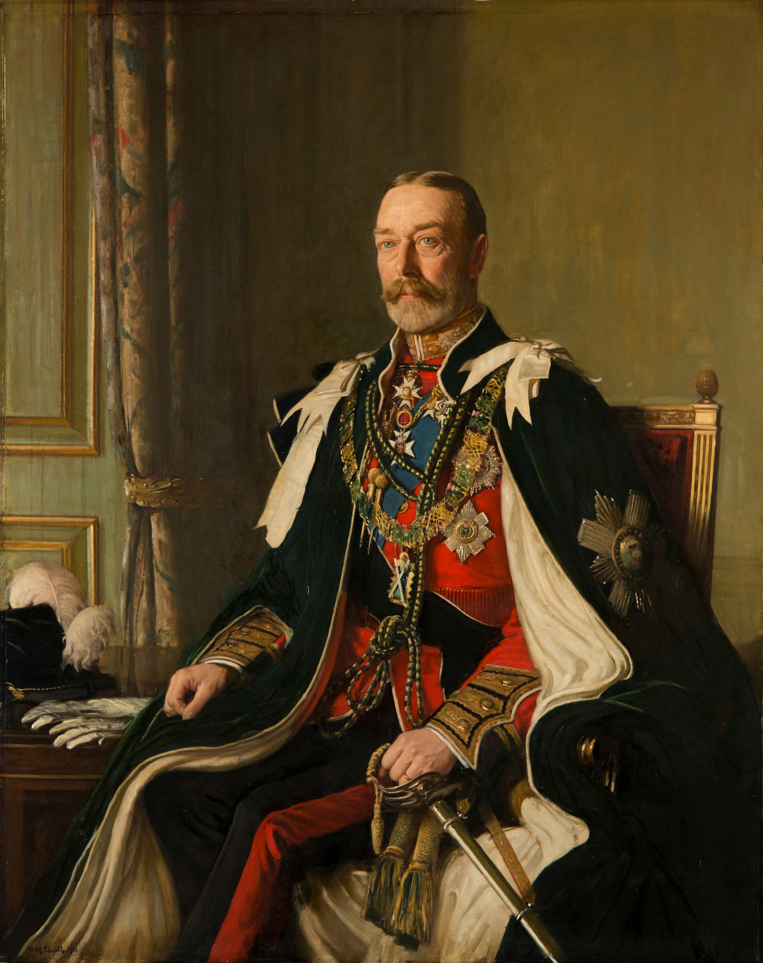
George V
In 1917, George became the first Windsor monarch and he renamed the House of Saxe-Coburg and the House of Gotha due to anti-German opinion. George suffered from smoking-related health problems for most of his subsequent reign.

Slide 10
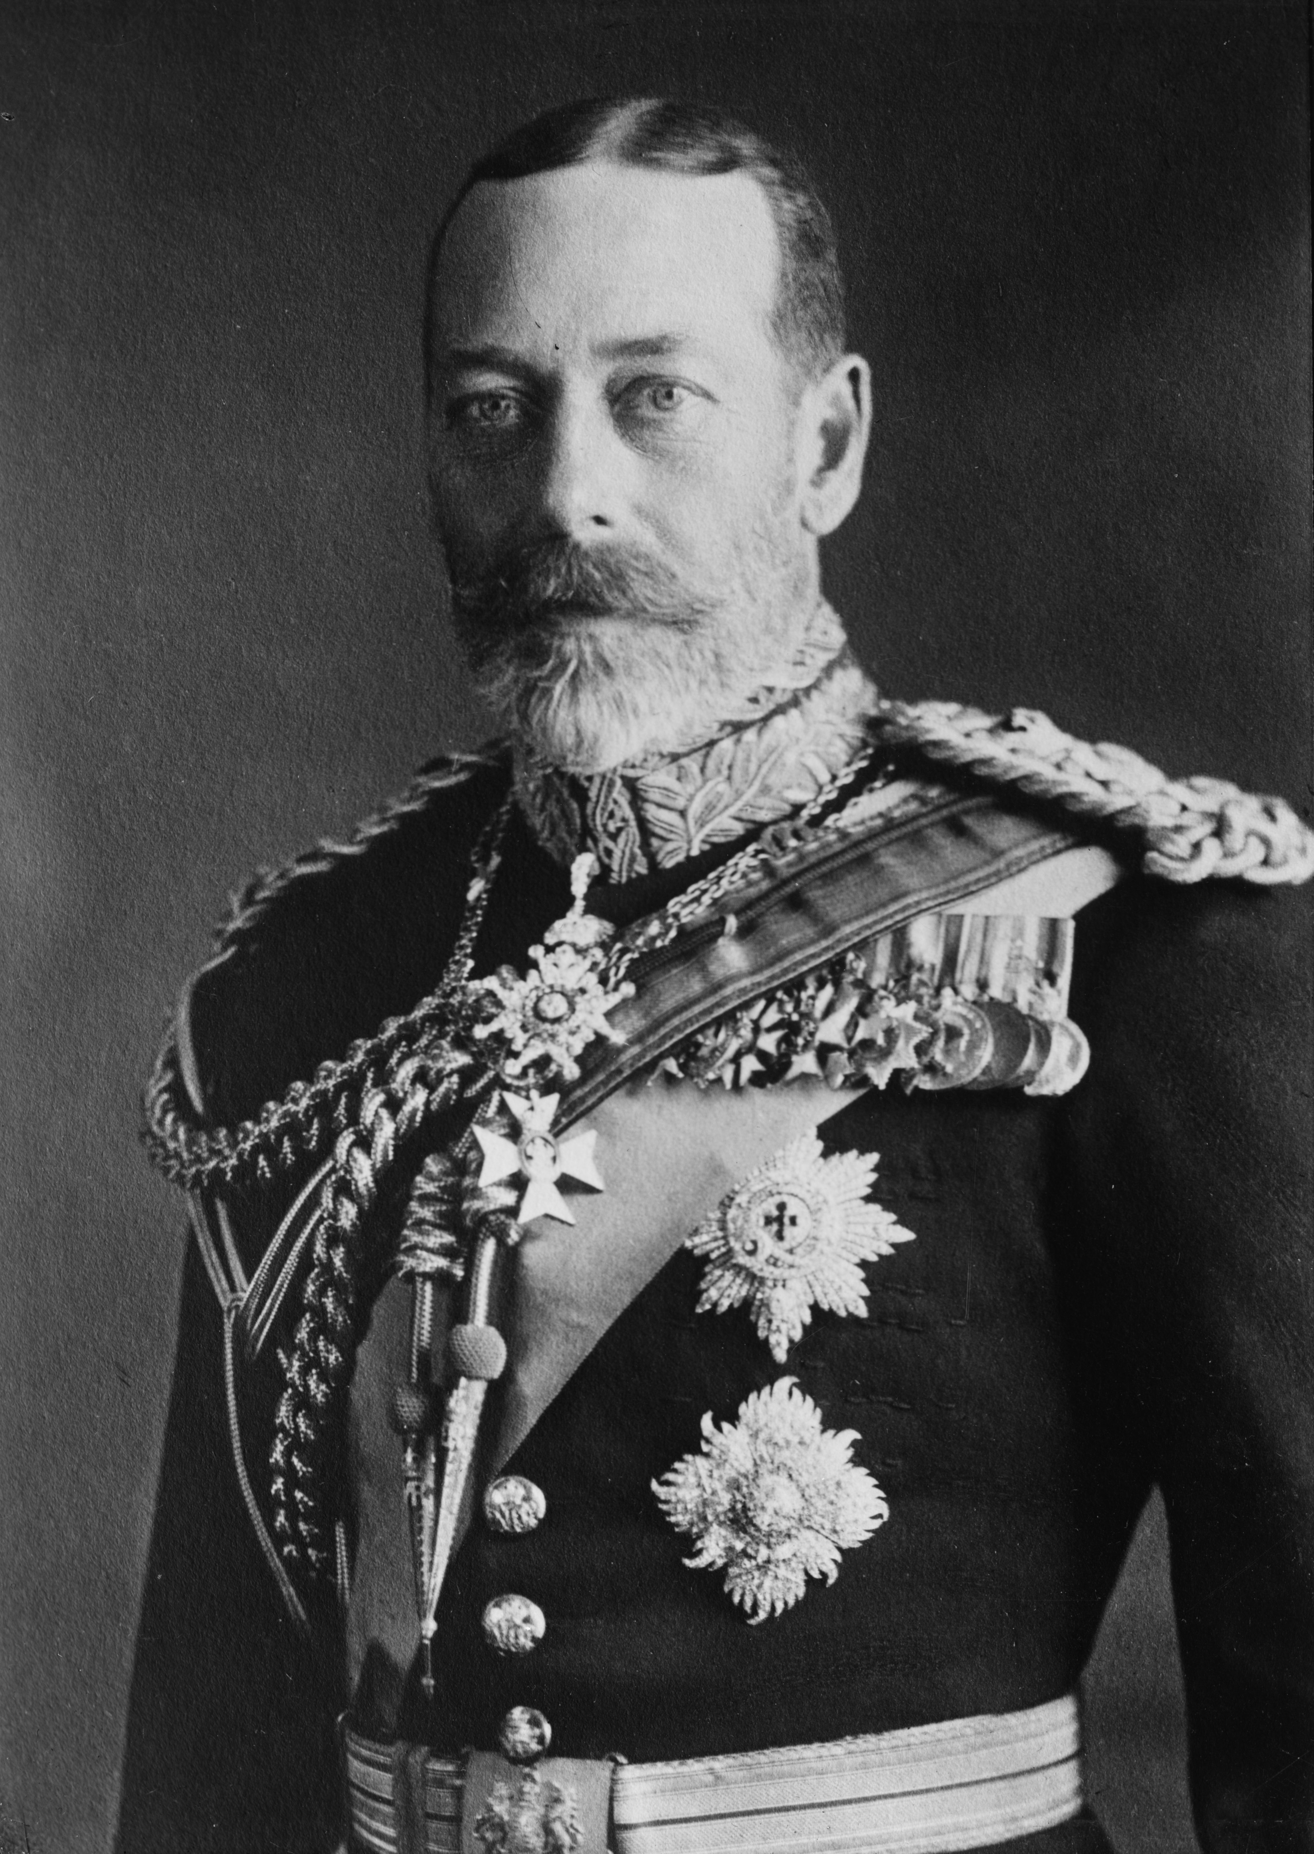
George V
On January 20th, 1936, the king George V died. His doctors, headed by Lord Dawson of Penn, issued a bulletin that 'the King's life is coming to a peaceful end'.

Slide 11
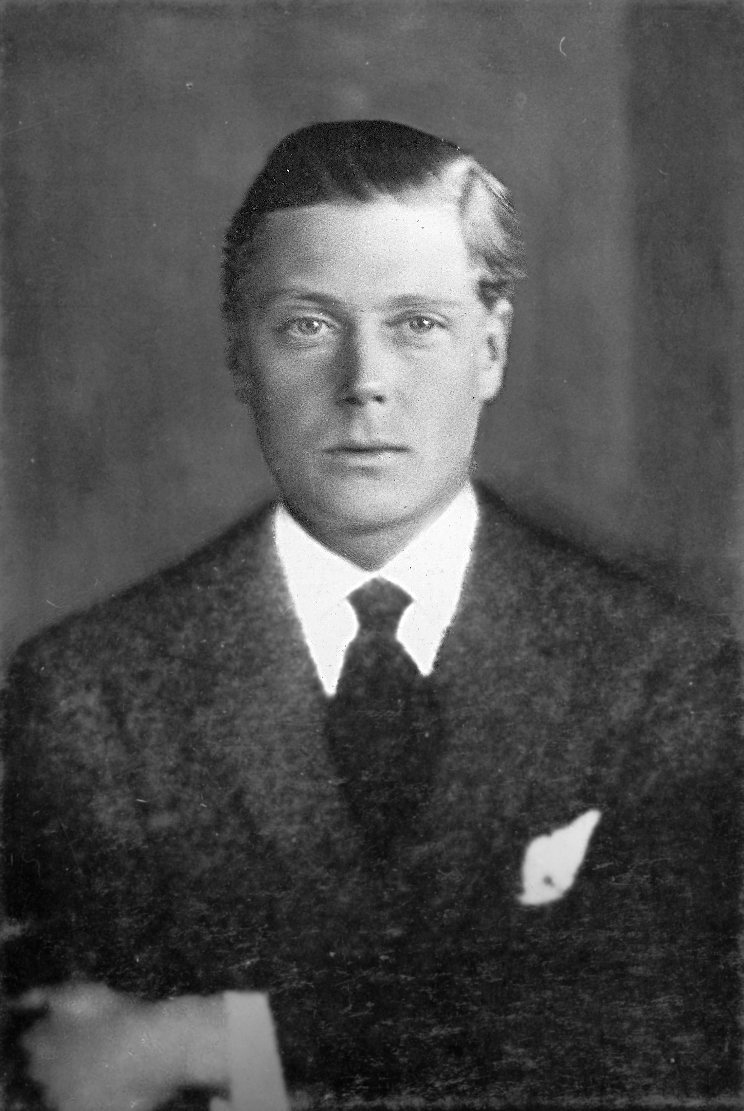
Edward VIII
Edward was born on June 23, 1894, at White Lodge, Richmond Park, outside London. He was the eldest son of the Duke and Duchess of York.
He was crowned Prince of Wales on his 16th birthday, seven weeks after his father became the king. As a young man, Edward served in the British Army during World War I and made several trips abroad on behalf of his father.

Slide 12
Edward VIII
After his father's death in 1936, Edward became the second monarch of the House of Windsor. The new king did not follow the court records and established constitutional conventions, which caused concern among politicians. Just months into his reign there was a constitutional crisis because Edward proposed marriage to Wallis Simpson, an American who was divorced twice. The British Ministers opposed the marriage and stated that a divorced woman with two living ex-husbands would not be politically and socially acceptable as the Queen. Edward knew that the Baldwin administration would resign if the marriage took place. It would have forced a general election. That’s why he abdicated. His reign lasted 326 days, making him one of the shortest reigning British monarchs ever.

Slide 13
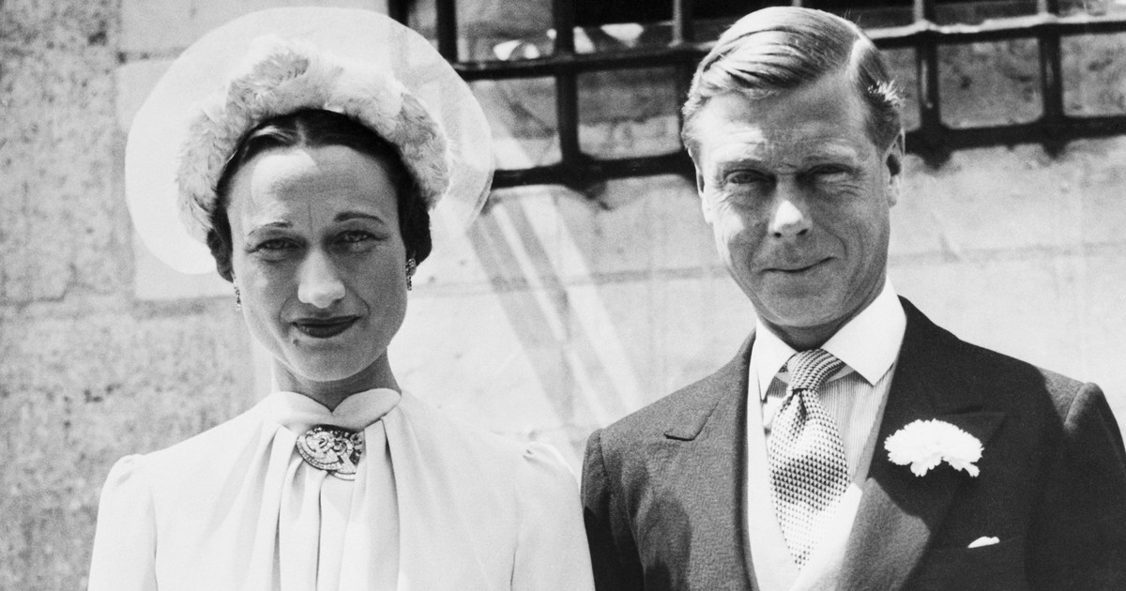
Edward VIII
After his abdication, Edward became Duke of Windsor. He married Simpson in France on June 3, 1937, after her second divorce was finalized. Later that year, the pair toured Nazi Germany, fueling rumors that he was a Nazi sympathizer. During World War II, Edward was initially stationed with a British military mission in France, but next he was appointed Governor-General of the Bahamas. After the war, Edward spent the rest of his life in France.

Slide 14
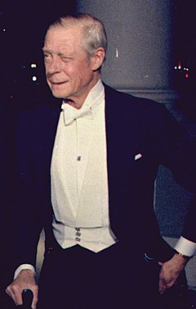
Edward VIII
Edward died at his home in Paris on May 28, 1972, ten days after Elizabeth's visit. His body was returned to England and kept in St George's Chapel, Windsor Castle. He and Wallis remained married until his death in 1972. They had no children.

Slide 15
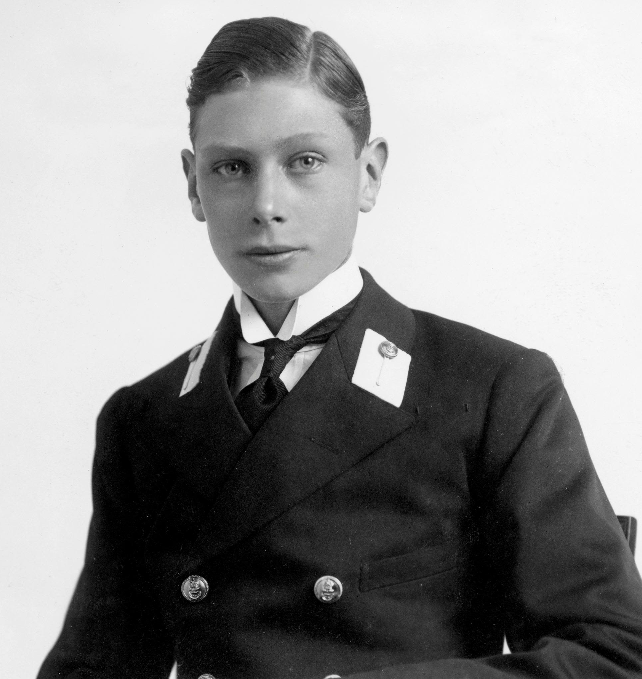
George VI
Albert was born on 14 December 1895. The future George VI was born in the reign of his great-grandmother Victoria. He was named Albert, Prince of His Consort, after his great-grandfather and was known to his family and close friends as "Bertie".

Slide 16
George VI
Albert as a second son of George’s V, could not succeed to the throne. He spent his early years in the shadow of his heir, his older brother Prince Edward. Albert attended Naval School in his teens and served in the Royal Navy and Royal Air Force during World War I. In 1920, he became the Duke of York. In 1923 he married his Lady Elizabeth Bowes in Lyon and had two daughters: Elizabeth and Margaret. When Edward abdicated, Albert became his third monarch of the House of Windsor and took the honorific title of George VI.

Slide 17
George VI
In September 1939, the British Empire and most Commonwealth countries (with the exception of Ireland) declared war on Nazi Germany. Wars with the Kingdom of Italy and the Empire of Japan followed respectively his 1940 and his 1941.
The Buckingham Palace was bombed during the War of the Blitz when the King and Queen were there. George became a symbol of Britain's determination to win the war. Britain and its allies won in 1945. As the British Empire had problems, George assumed the new title of Head of Commonwealth.

Slide 18
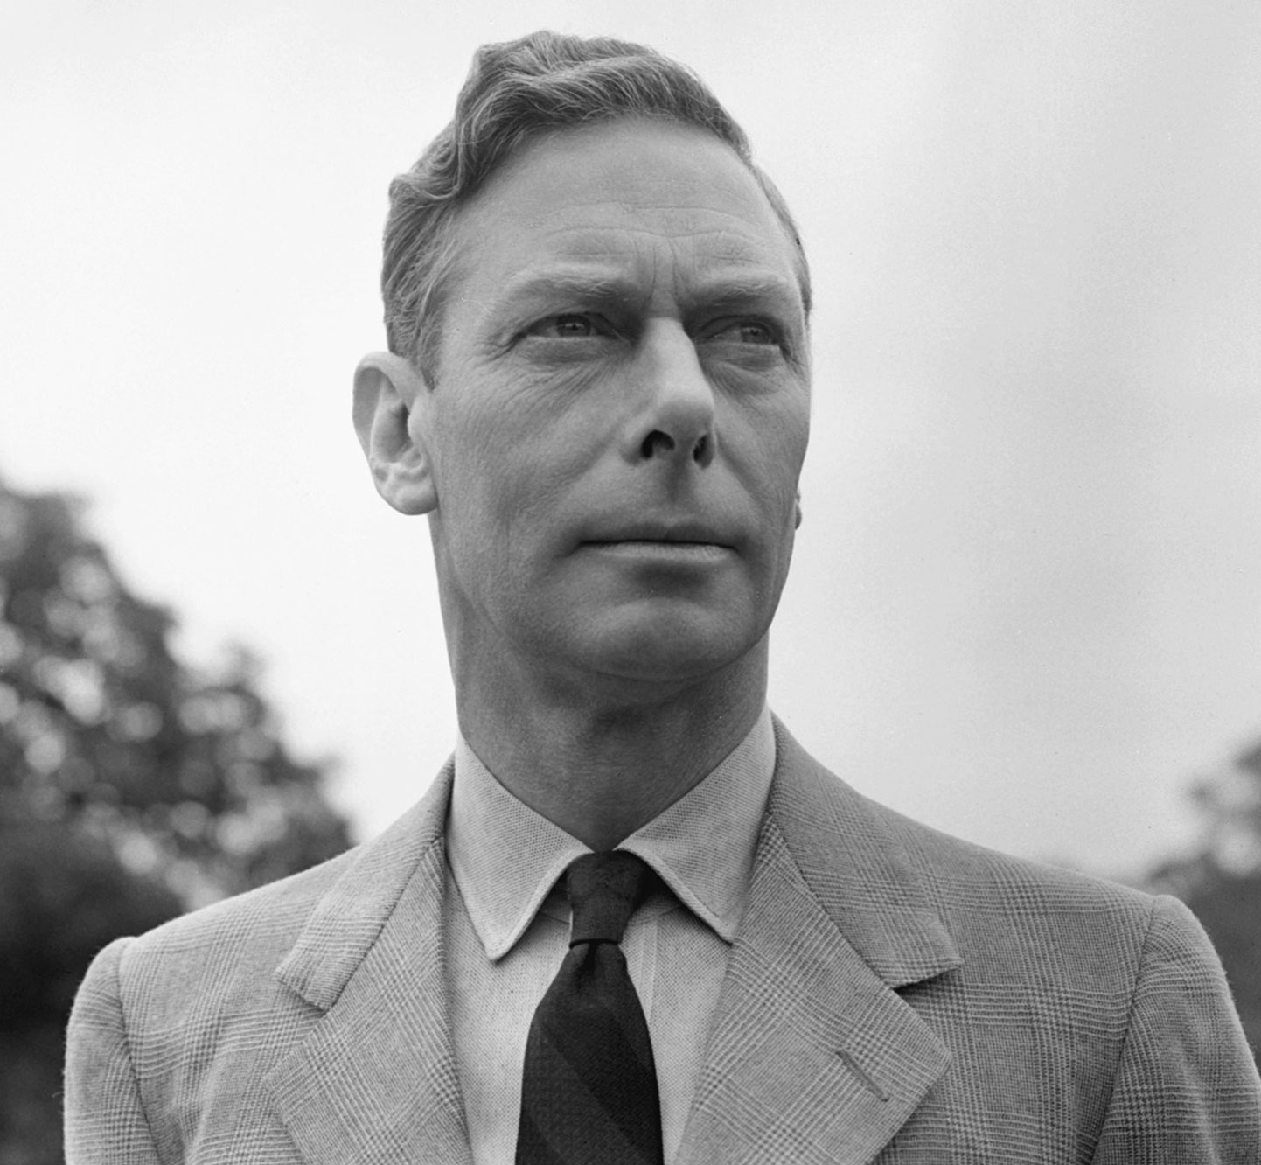
George VI
On 31 January 1952, despite the advice of people close to him, George went to London airport to see Elizabeth and Philip off on a long – planned international tour. It was his last public appearance. After 6 days he was found dead in his bed at Sandringham House in Norfolk. He suffered from smoking-related health problems later in his reign and died of coronary thrombosis in 1952.

Slide 19
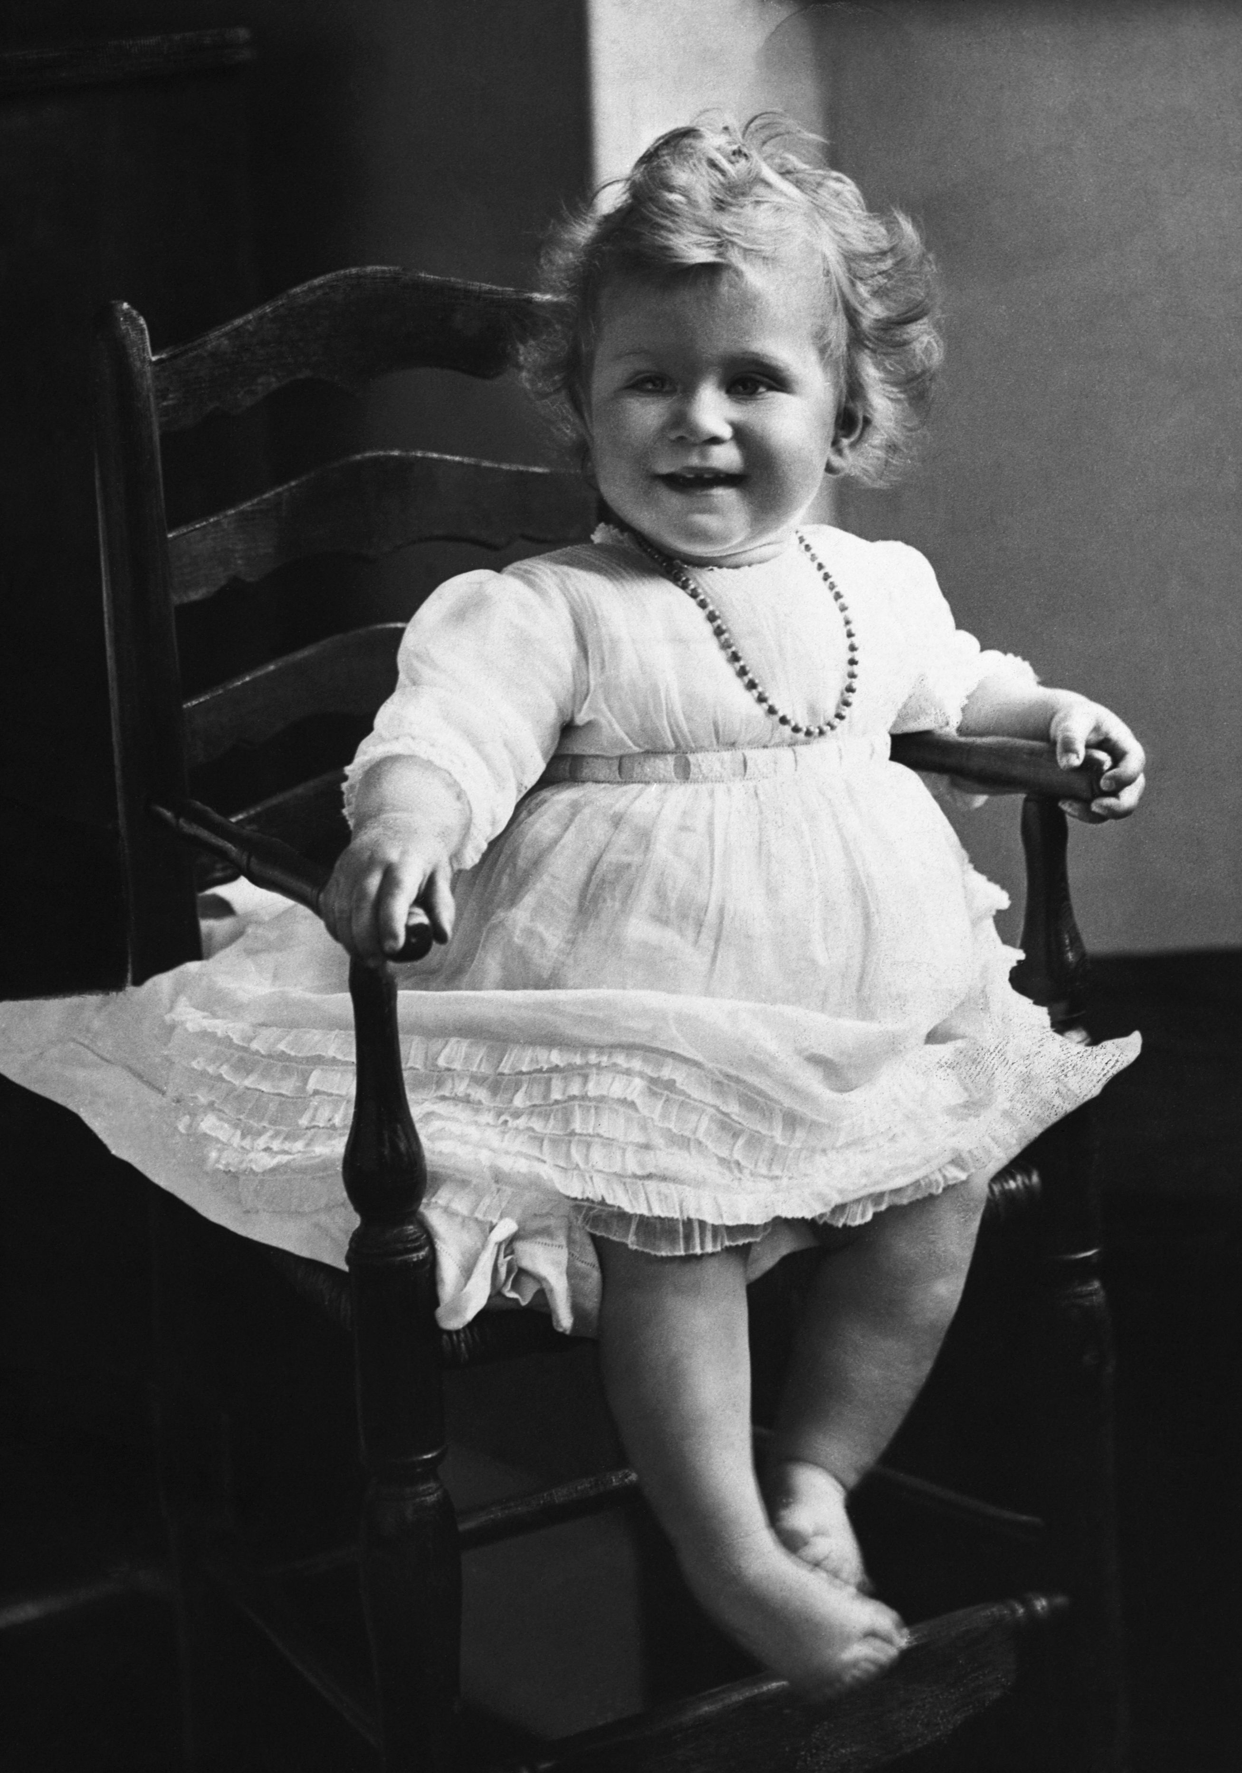
Elizabeth II
Elizabeth was born on April 21, 1926, as the first child of Prince Albert, Duke of York and his wife Elizabeth, Duchess of York.
Her father, George VI, ascended to the throne in 1936 after his brother Edward VIII abdicated, making 10-year-old Princess Elizabeth his heir presumptive.

Slide 20
Elizabeth II
Raised privately at home, she began public service during World War II, serving in rural relief services. In November 1947, she married Philip Her Mountbatten, former Prince of Greece and Denmark, with whom she remained married for 73 years until his death in 2021. When her father died in February 1952, Elizabeth, then 25, became Queen of seven independent Commonwealth countries.
Elizabeth reigned as a constitutional monarch through major political changes such as the Northern Ireland problem, the decentralization of Britain, the decolonization of Africa, Britain's accession to the European Community and Brexit from the EU.

Slide 21
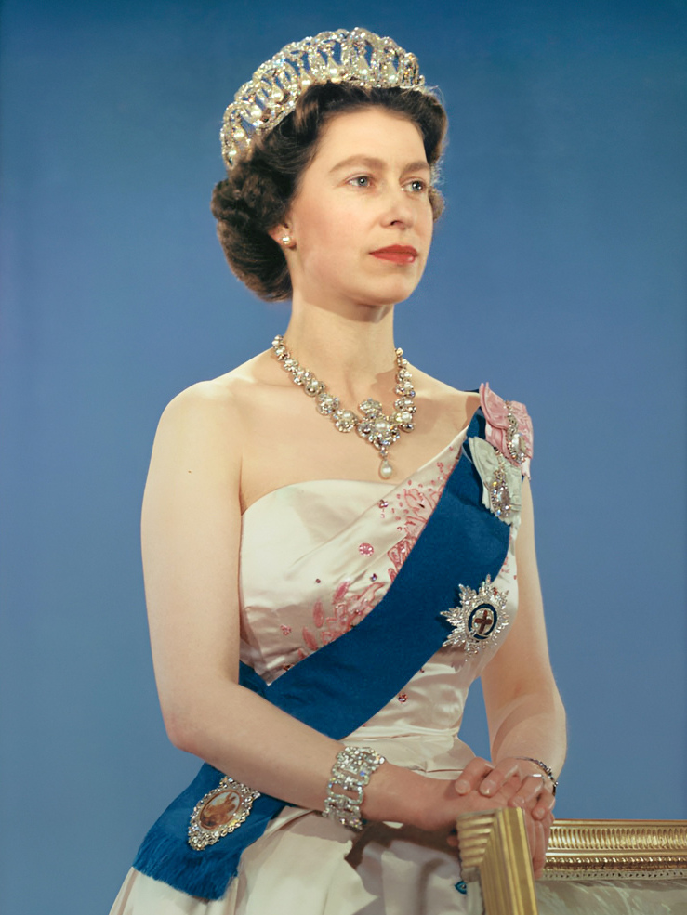
Elizabeth II
Significant events include Elizabeth's 1953 coronation and the respective Silver, Gold, Diamond and Platinum Jubilee Celebrations of 1977, 2002, 2012 and 2022. Because of her personal popularity, her support for the British monarchy remained consistently high throughout her life.

Slide 22
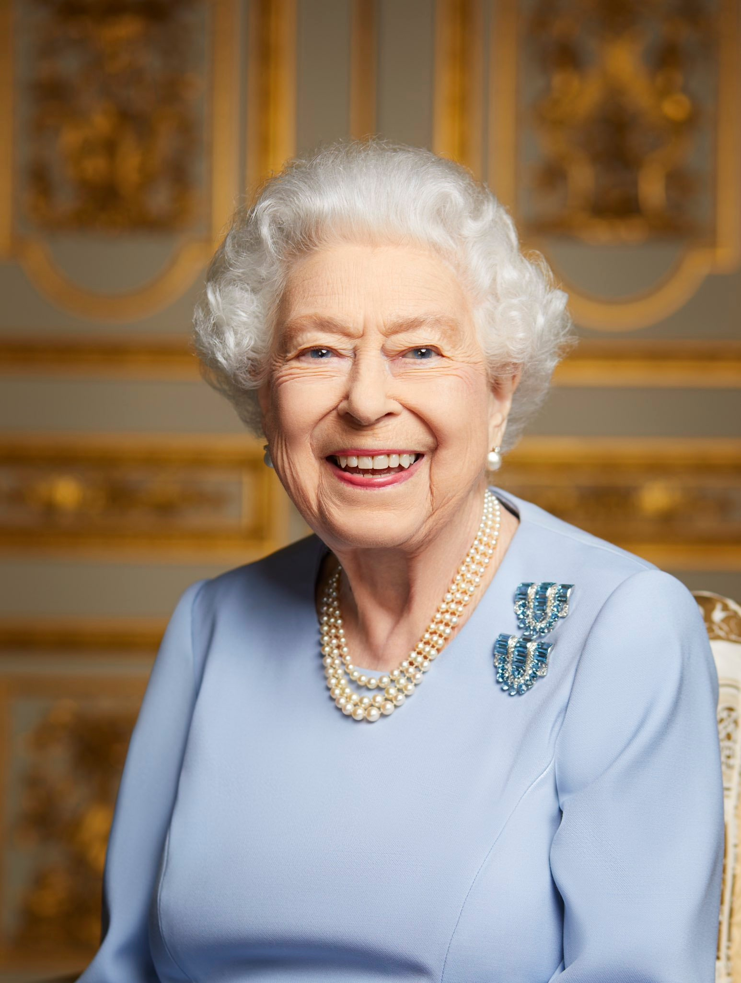
Elizabeth II
Elizabeth died in September 2022 at Balmoral Castle, Aberdeenshire, at the age of 96.

Slide 23
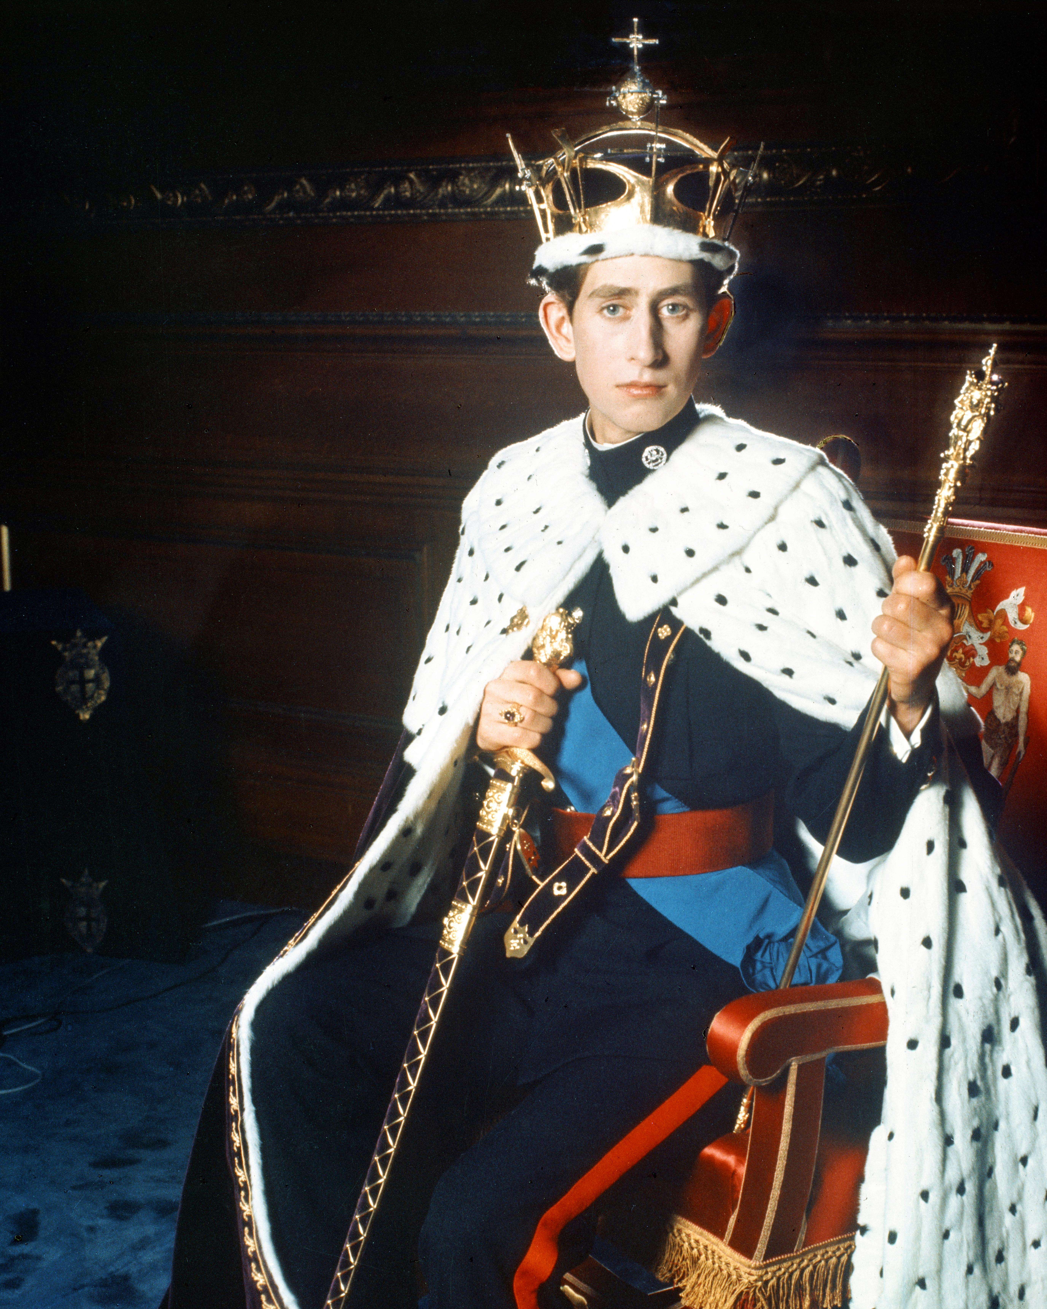
Charles III
Charles was born on 14 November 1948.
He was three years old when his mother, Elizabeth II, ascended the throne in 1952.

Slide 24
Charles III
He became Prince of Wales in 1958. After graduating with a Bachelor of Arts degree from Cambridge University, Charles served in the Royal Air Force and Navy for five years from 1971. He married Lady Diana Spencer in 1981 and has two sons: William and Harry. The couple divorced in 1996. Diana died in a car accident the following year.
In 2005, Charles married his longtime partner - Camilla Parker-Bowles. As apparent heir, Charles assumed public duties and duties on behalf of his mother. He founded his youth charity The Prince's Trust in 1976, sponsors The Prince's Charities, and he is a patron, president, or member of over 400 other charities and organizations.

Slide 25
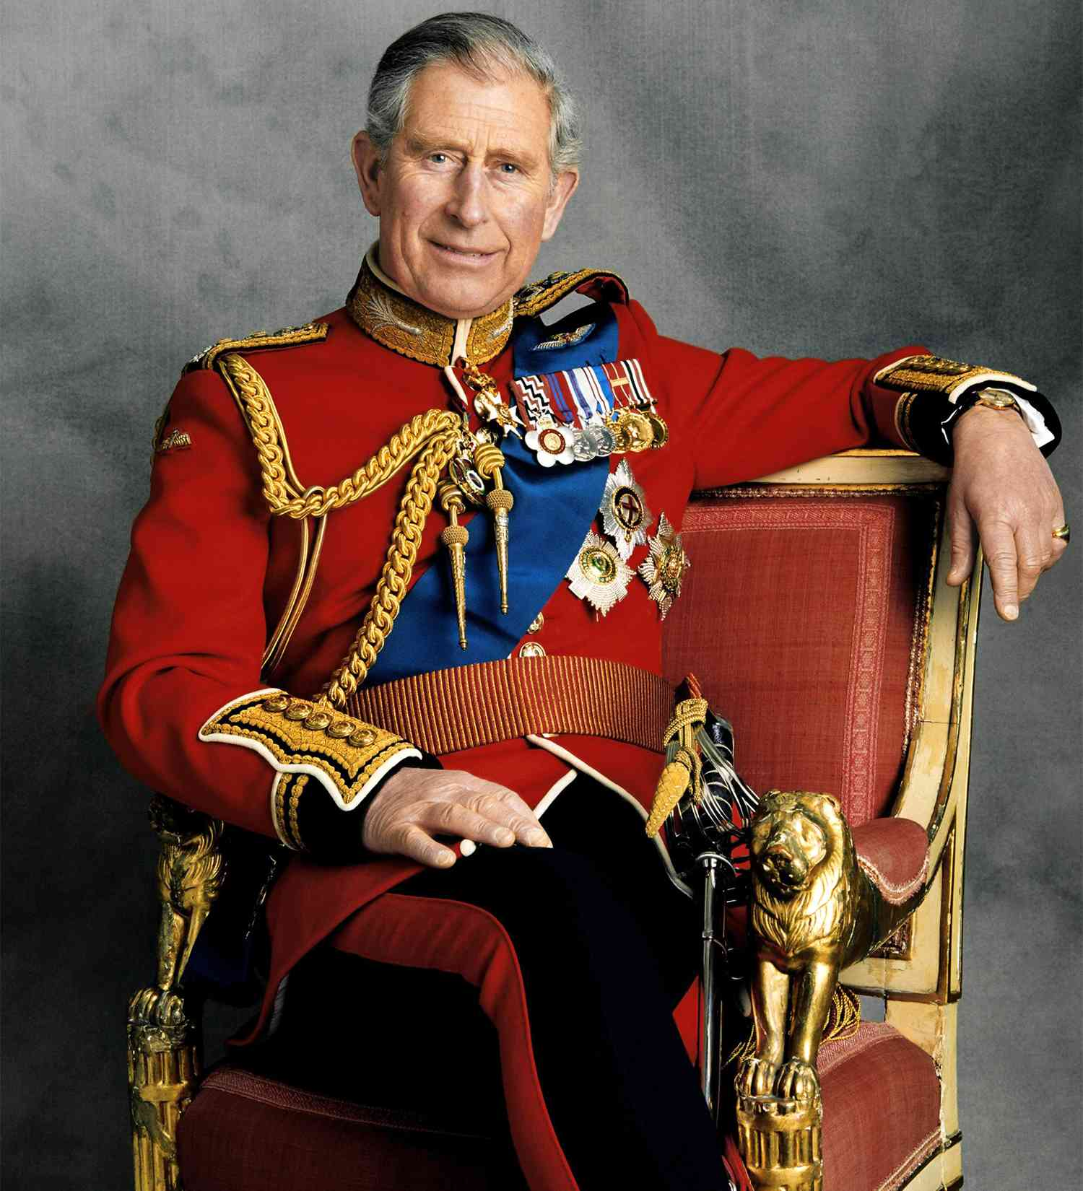
Charles III
Charles succeeded his mother on September 8, 2022 after her passing. At 73, he became the oldest person to ascend to the British throne and the longest waiting heir in British history. His coronation took place on 6 th May 2023.

Slide 26
Rest of the members

Slide 27
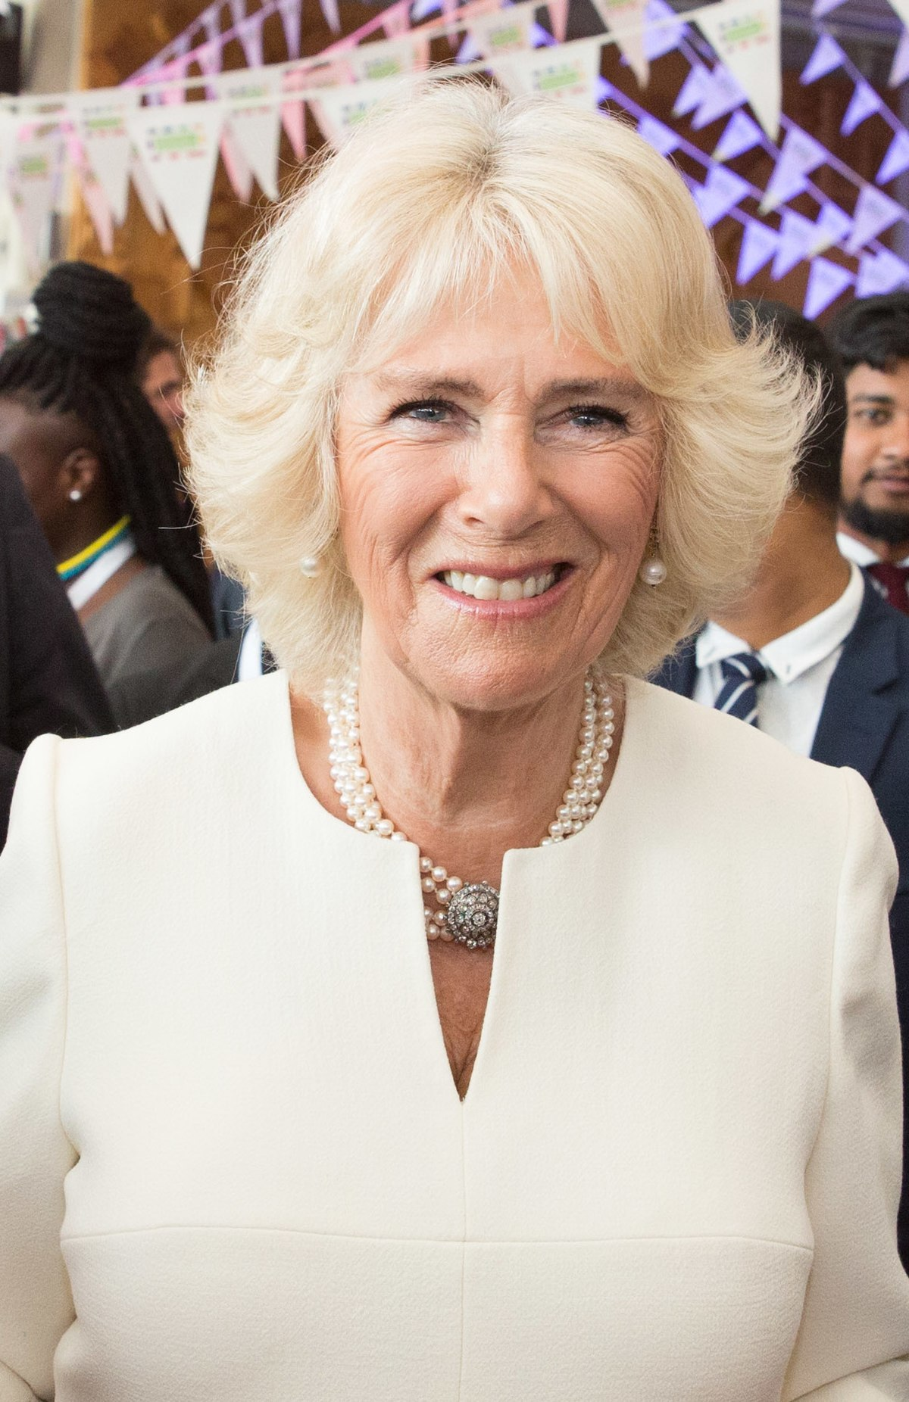
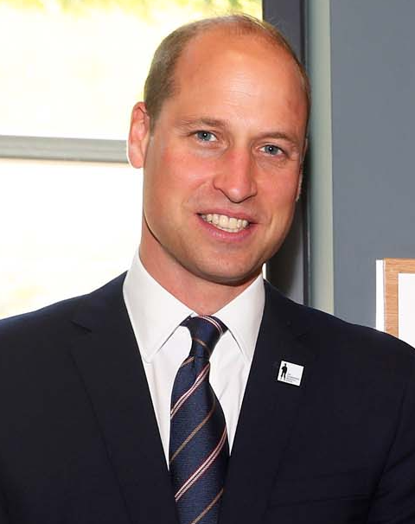
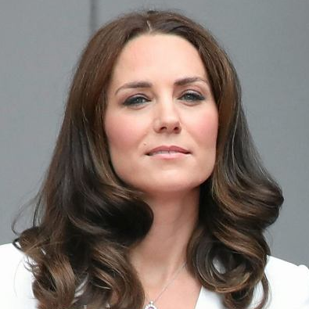
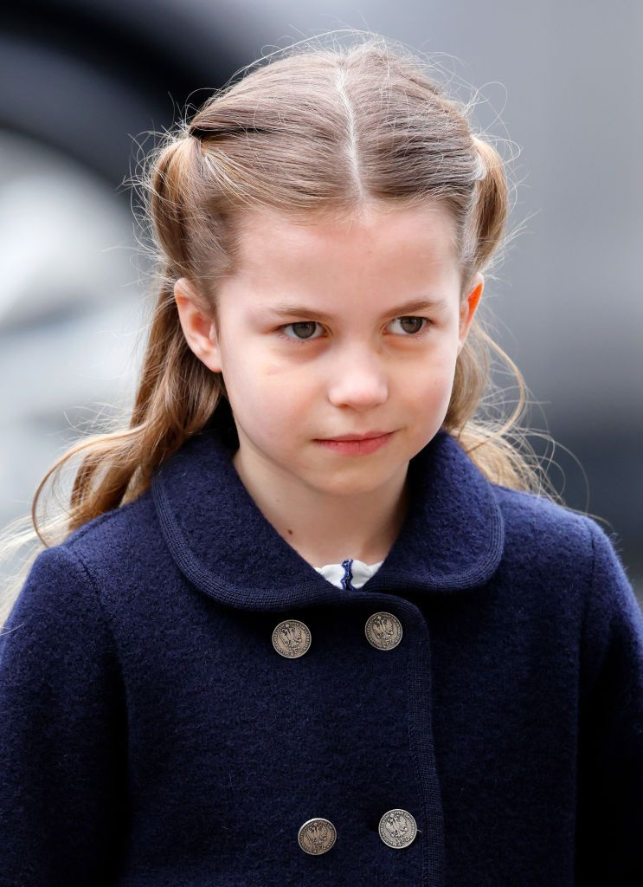
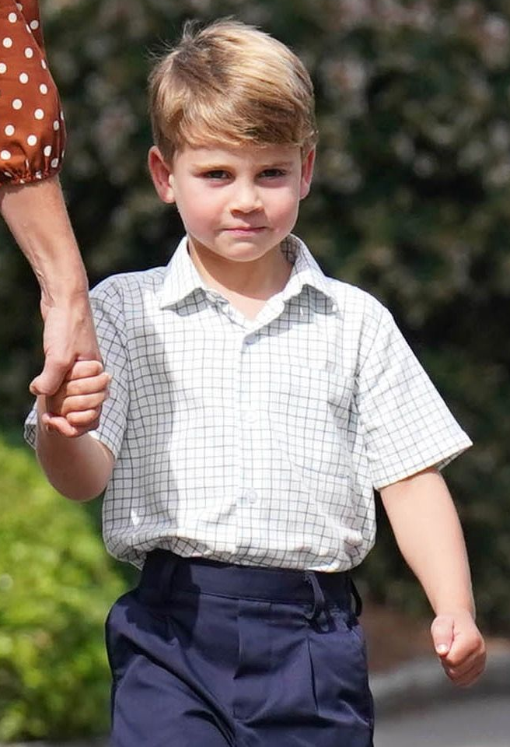
Camilla
William
Catherine
George
Charlotte
Louis
Queen Consort
Prince of Wales
Princess of Wales

Slide 28
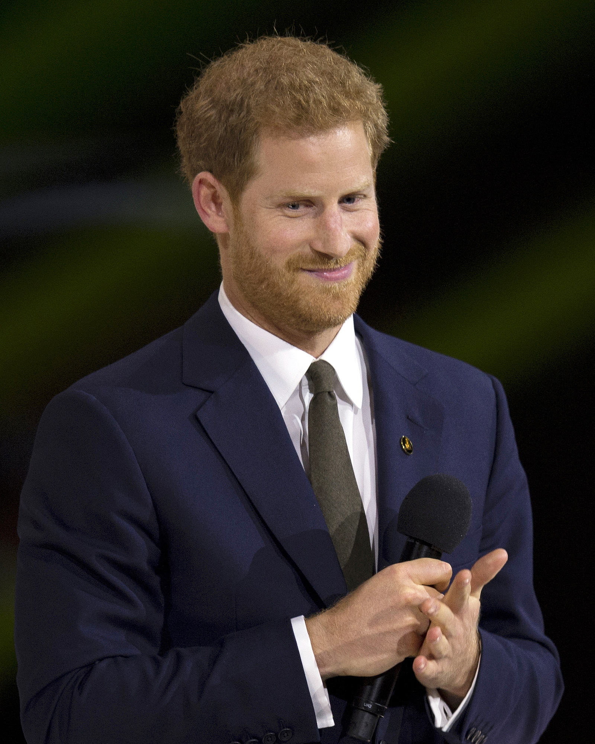
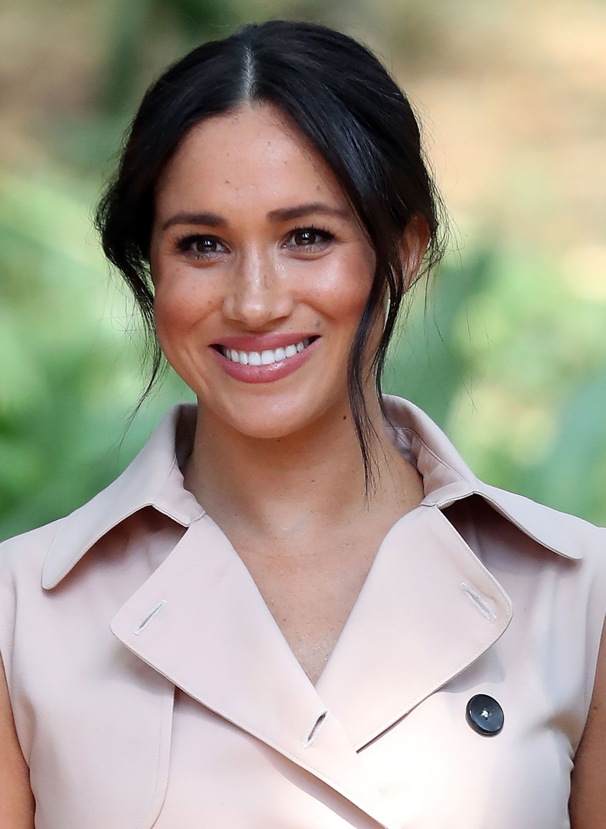
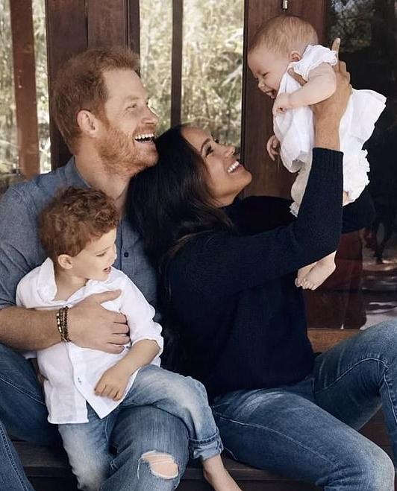
Harry
Meghan
Archie & Lilibet
Duke of Sussex
Duchess of Sussex
Princess of Wales

Slide 29
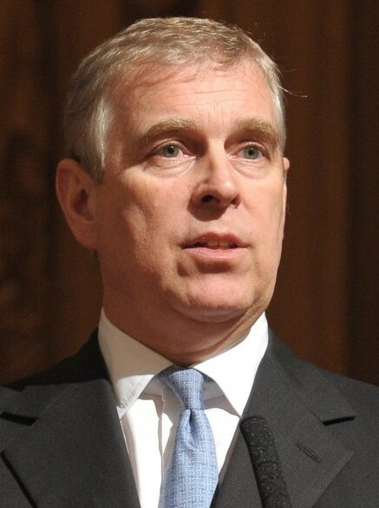
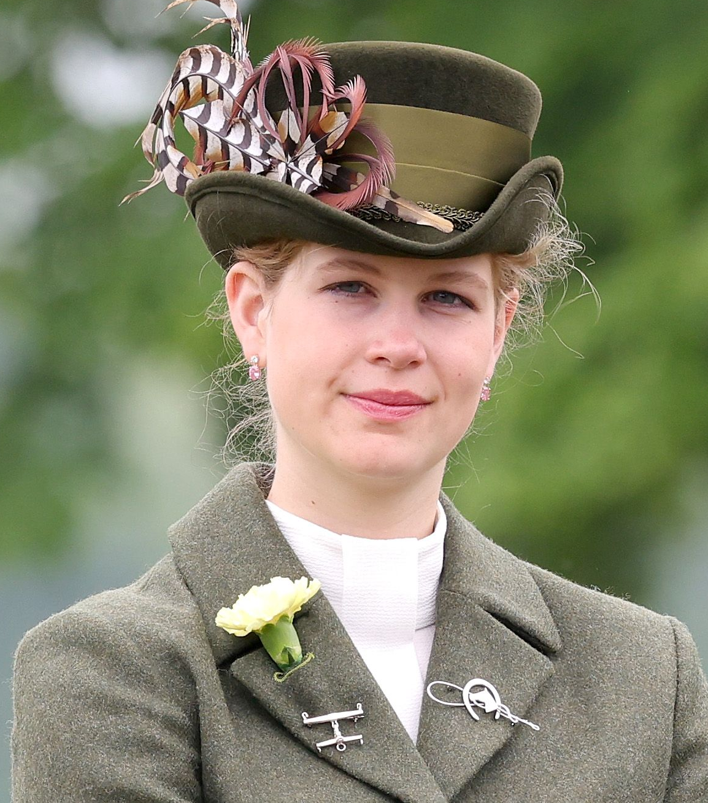
Andrew
Beatrice
Eugenie
Edward
Sophie
Louise
Duke of York
Princess
Princess
Duke of Edinburgh
Duchess of Edinburgh
Lady

Slide 30
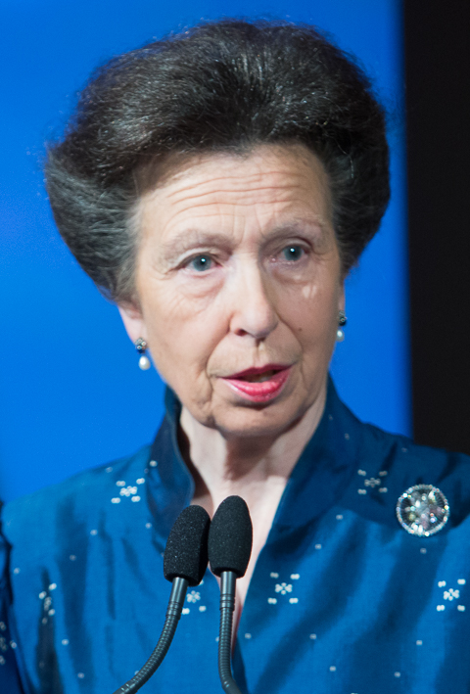
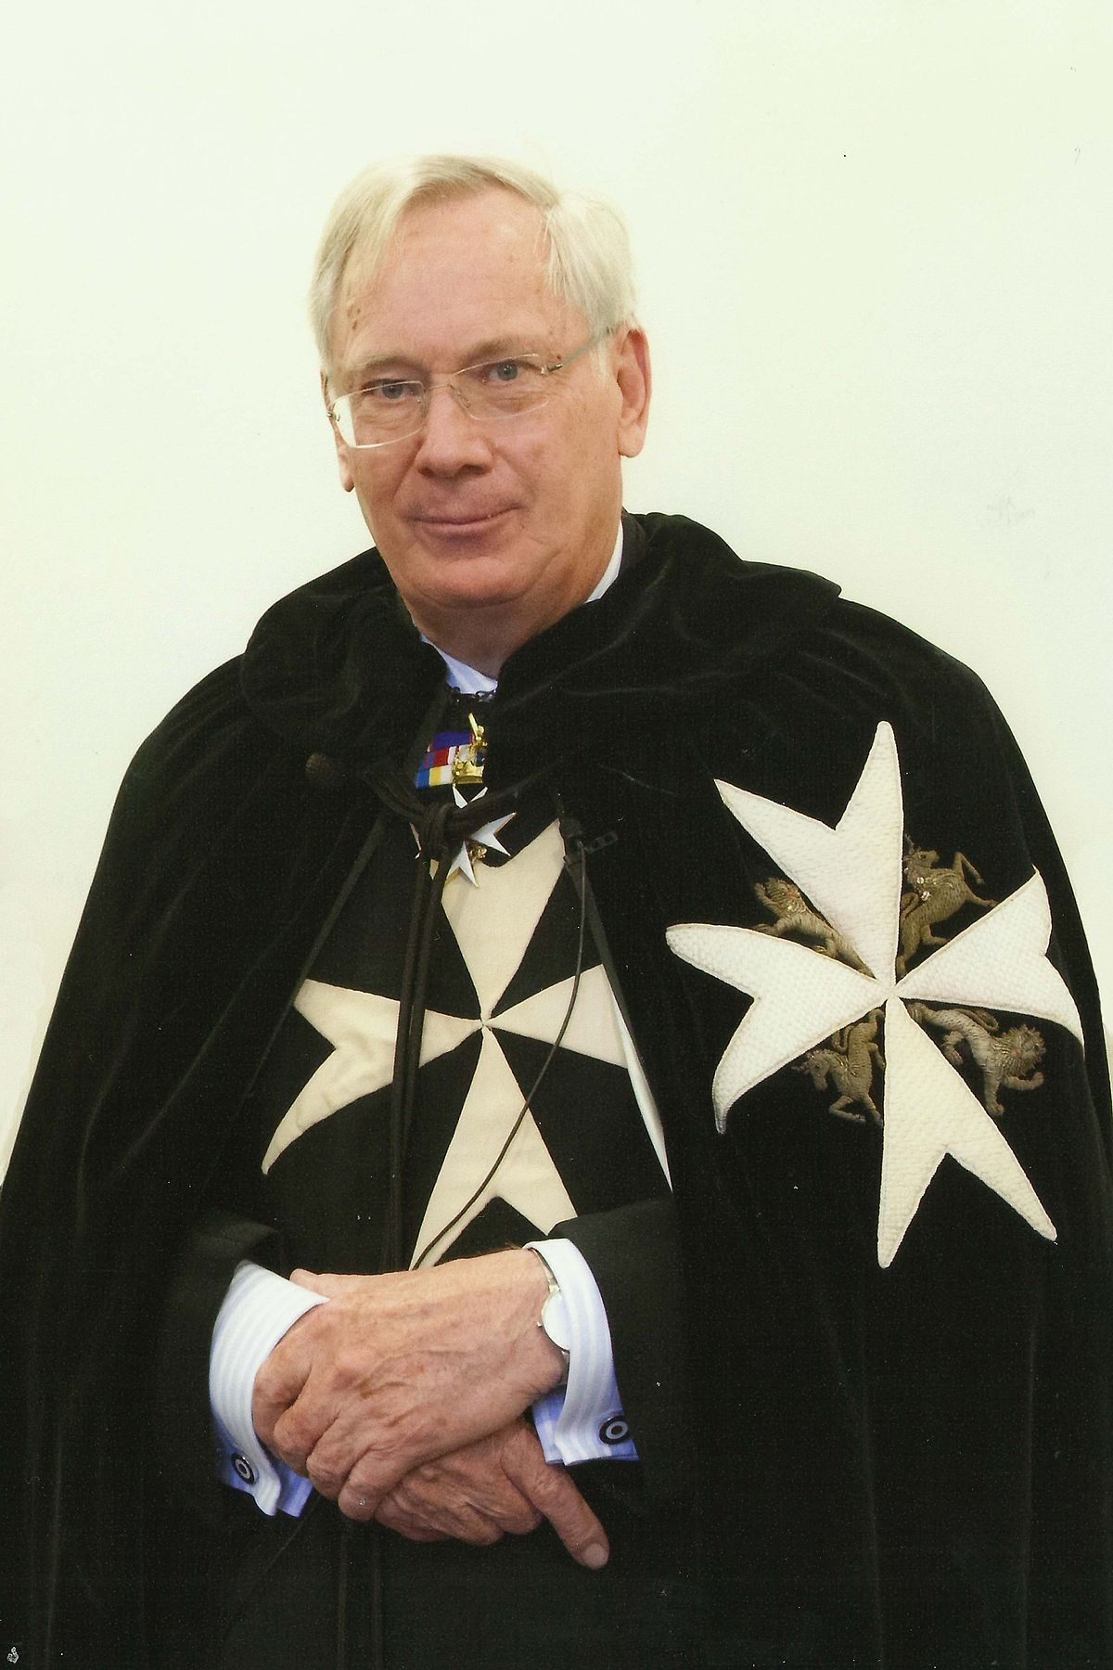
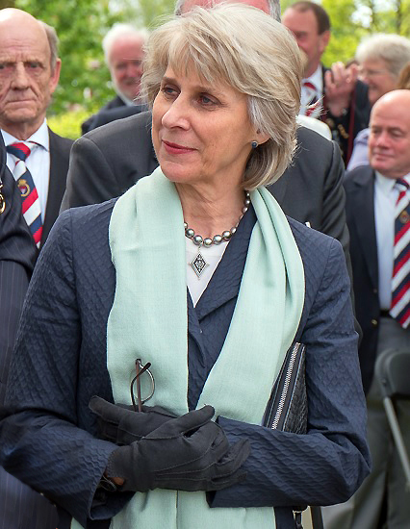
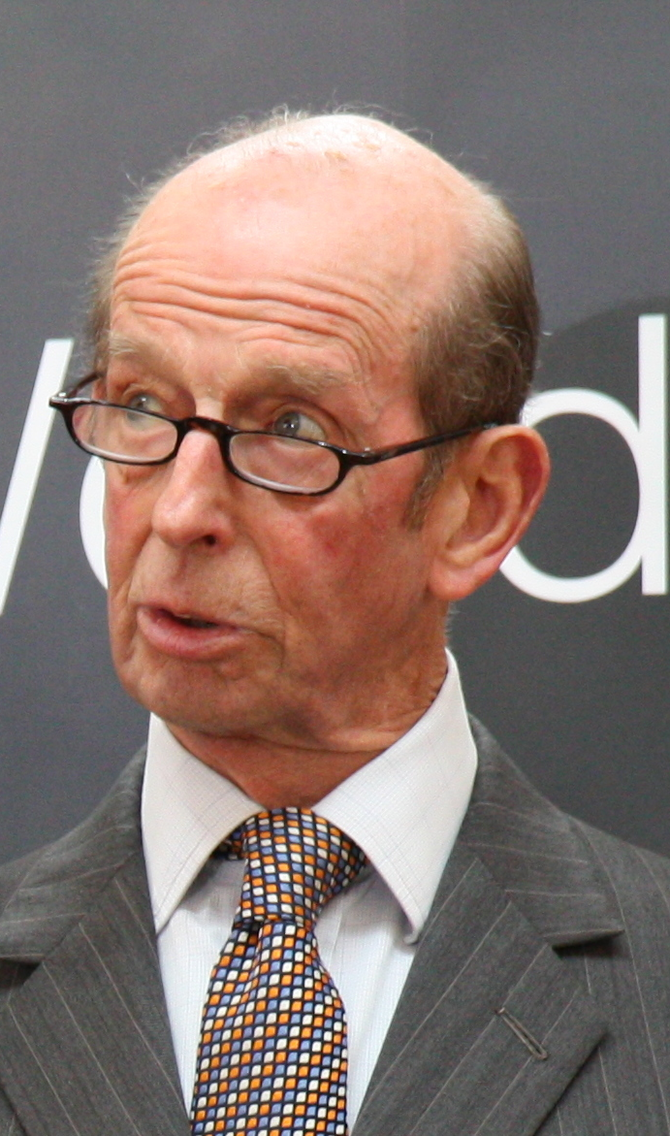
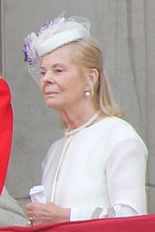
James
Ann
Richard
Birgitte
Edward
Katherine
Earl of Wessex
Princess Royal
Duke of Gloucestrer
Duchess of Gloucestrer
Duke of Kent
Duchess of Kent

Slide 31
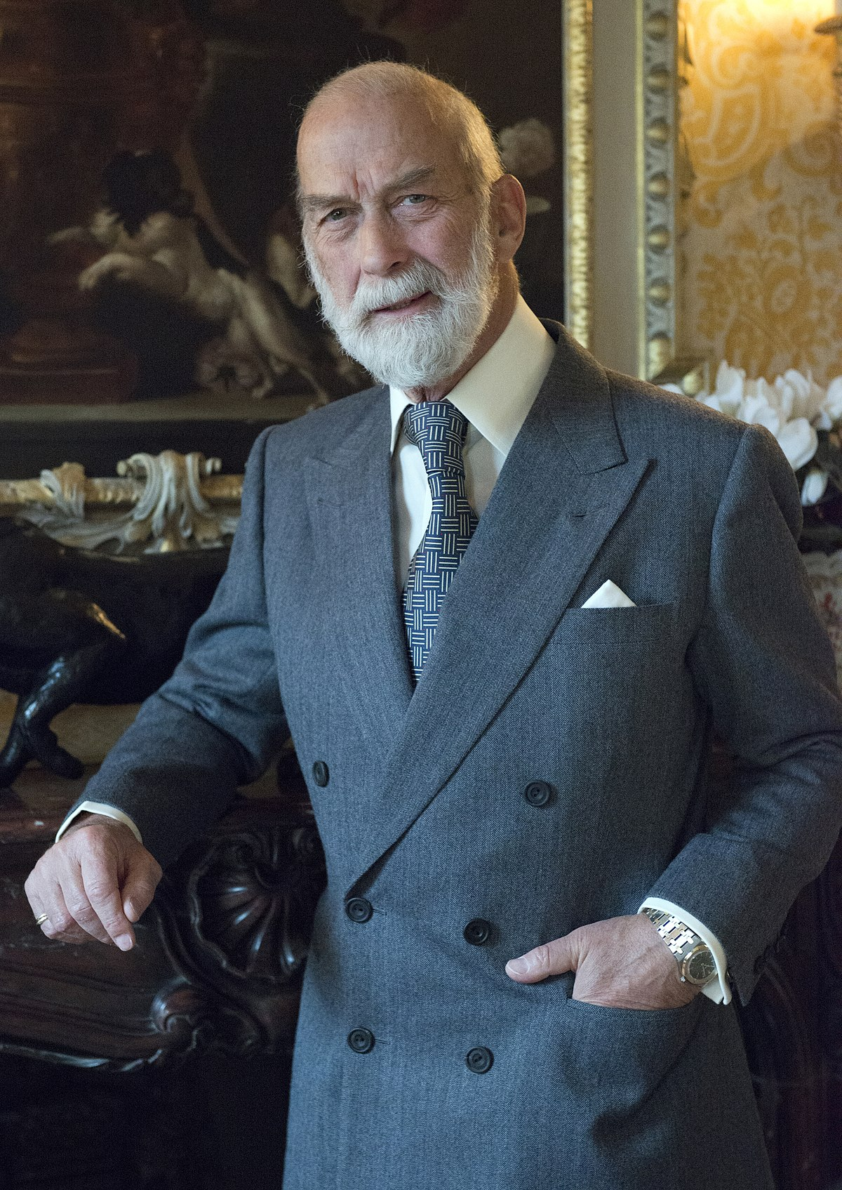
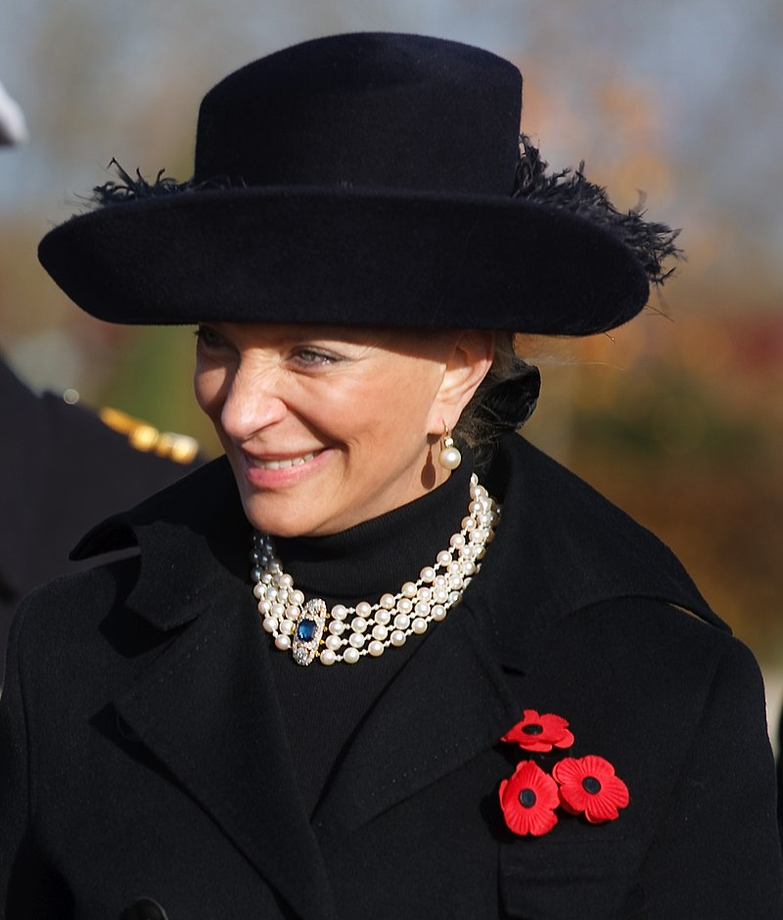
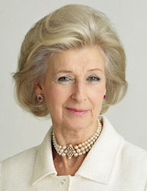
Michael of Kent
Marie Christine
Alexandra
Prince
Michael of Kent
Princess Oglivy

Slide 32
Thanks for listening!

Slide 33
Biography
Royal UK
Wikipedia
Instagram – The Royal Family
Twitter – The Royal Family
BBC

