Slide 1
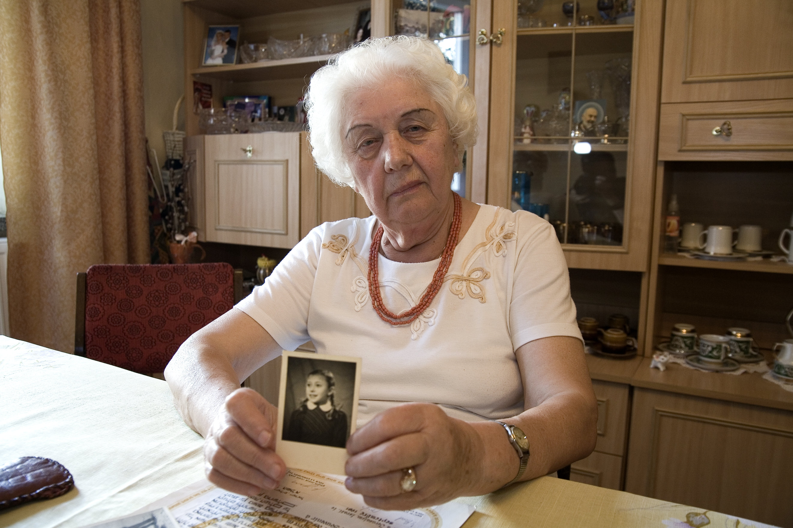
Righteous among the nations
„Whosoever saves a single life, saves an entire universe"
Mishnah, Sanhedrin 4:5
Helena Kożuch - Śleszyńska neé Pietrzak

Slide 2
Helena Śleszyńska-Kożuch z domu Pietrzak wraz z ojcem Mikołajem Pietrzakiem od 1942 r. przez 3,5 roku ukrywali w swoim domu żydowską dziewczynkę trzyletnią Sonię Broder, której rodzice przebywali w częstochowskim getcie. Sonia i jej rodzice przeżyli wojnę. Wyjechali do Izraela ale utrzymywali kontakt z Państwem Pietrzaków. Dzięki ich staraniom 8 maja 1979 r. zostali odznaczeni Medalem „Sprawiedliwi Wśród Narodów Świata”.
During the war Helena Kożuch-Śleśzyńska neé Pietrzak and her father Mikołaj hid a 3-year old Jewish girl Sonia Broder in their house for 3 and a half years. Her parents were in the ghetto at that time. They all survived the war and then moved to Israel staying in touch with The Pietrzak family.On May 8, 1979, Yad Vashem recognized Mikołaj Pietrzak and his daughter Helena Kożuch-Śleszyńska neé Pietrzak as Righteous Among the Nations.

Slide 3
Sonia Broder
Oto jej wspomnienia: Rodzice Sonii bardzo prosili, żeby ją uratować. W getcie jedno ich dziecko już zmarło. Był to młodszy brat Soni. Tylko ona jedna im została. Mój tato nie wahał się długo. Zgodził się i obiecał, że w razie śmierci Broderów Sonię będzie traktował jak córkę i stanie się ona członkiem naszej rodziny. Mama była bardziej sceptycznie do tego nastawiona. Bała się o nasze życie.
Akcja uratowania Soni była zaplanowana. To ja miałam ja wyprowadzić z getta.
Here are her memories: Sonia’s parents asked us to rescue her. One of their children had already died in the ghetto. It was her younger brother. She was their only child. My dad didn’t hesitate. Finally, he agreed and promised that in case of the Broders ‘ death he would treat Sonia as his daughter and that she would become a member of the family. Mum was rather sceptical of this. She feared our family would suffer because of that.
Getting Sonia from the ghetto had been planned. I was supposed to get her from there.

Slide 4
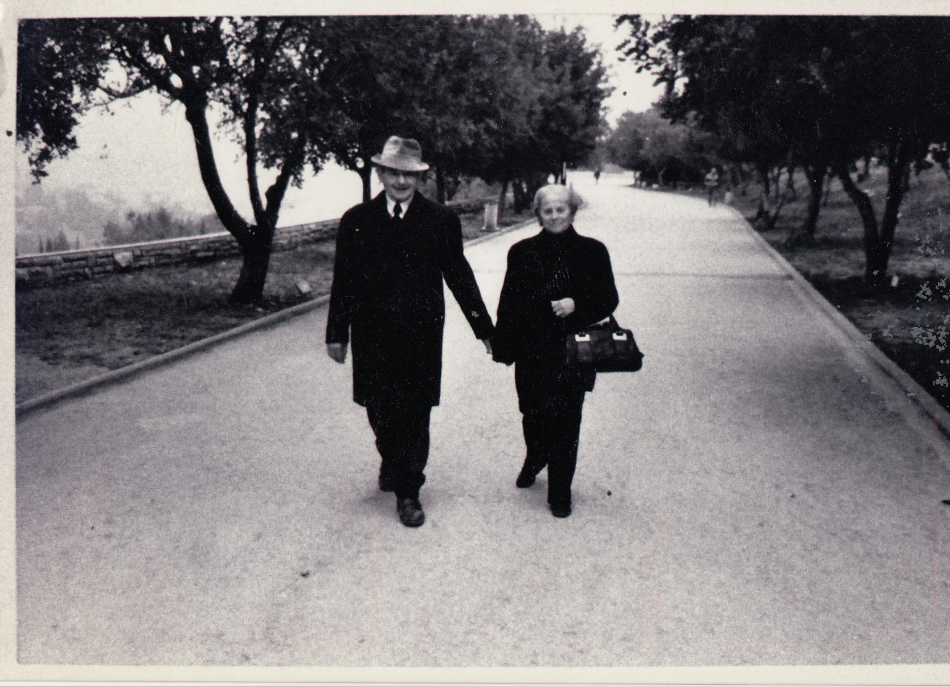
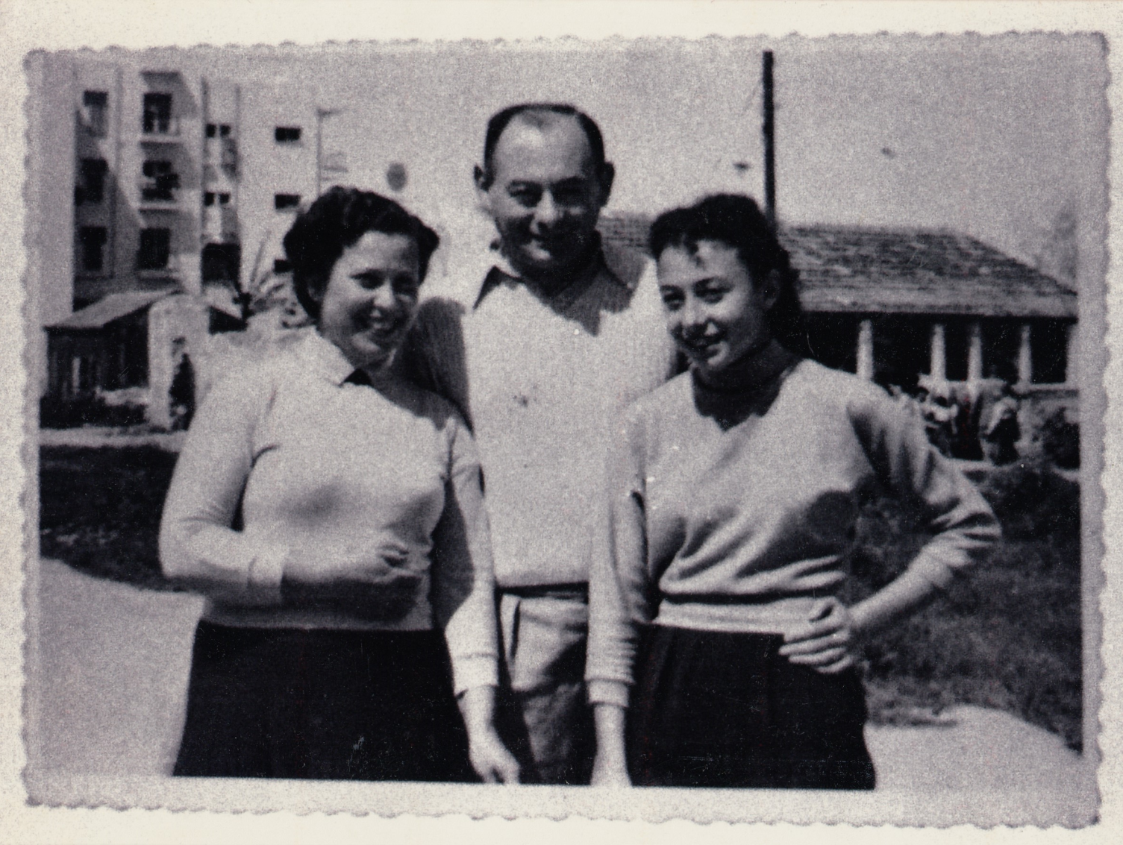
W naszym domu Sonia miała dwie kryjówki. W pokoju za szafą i w kuchni. Sonia przebywała tam bardzo rzadko. Jedynie kiedy przyszedł ktoś nieznajomy. Wtedy na podwórku szczekał pies i ona wiedziała, że musi się ukryć. Przez większość czasu Sonia siedziała z nami. Sąsiedzi o niej wiedzieli.
We organised two hiding places. In the living room, behind the wardrobe and in the kitchen. She hid there very rarely, only when somebody visited us. A dog started barking in the yard then and we knew that she had to hide. She spent most of the time with us. Neighbours knew her.
Jeden raz przyszli do naszego domu Niemcy, którzy szukali zbiegów. Sonia spała wtedy wraz ze mną. Na szczęście zajęci szukaniem zbiegów Niemcy nie zwrócili uwagi na śpiące dzieci.
Once Germans came to our house looking for runaways. Sonia was sleeping with me then. Fortunately, they didn’t pay any attention to sleeping kids.
Sonia’s parents
Helena Śleszyńska visiting Sonia and her husband in Israel

Slide 5
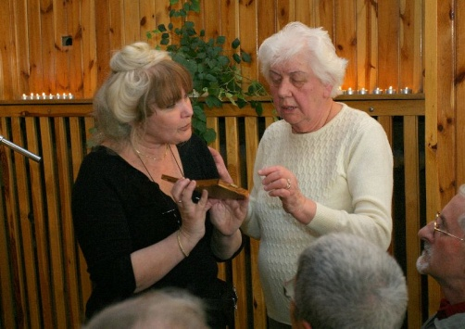
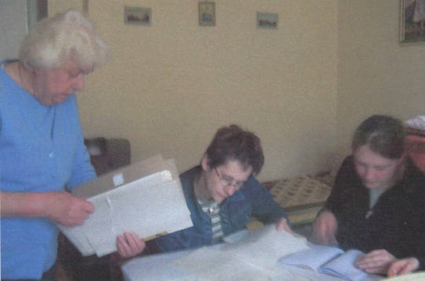
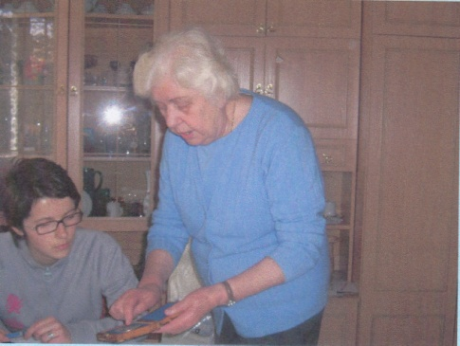
Sonia on her wedding day
Gdy przyszedł dzień wyzwolenia, okazało się, że rodzice Soni przeżyli. Jej mama przyszła po nią, ale ona chyba nawet jej nie rozpoznała. Płakała i bardzo nie chciała wrócić do domu. Jej mama przychodziła co kilka dni, żeby się Sonia mogła z nią oswoić. A kiedy w końcu mogła ja zabrać, ja musiałam jej obiecać, że każdego dnia będę ją odwiedzać. Po wojnie dopóki nie wyjechali, widziałam się z Sonią codziennie. Później jej rodzina wyjechała do Stuttgartu, a trzy lata później wyjechali do Izraela.
After liberation her mum came but she didn’t recognise her. She didn’t want to go with her. So her mum decided to visit us every few days. Finally, when she was leaving I had to promise to visit her every day. After the war I saw her every day. Then her family went to Stuttgart. They were there for three years and moved to Israel.
2007
2005

Slide 6
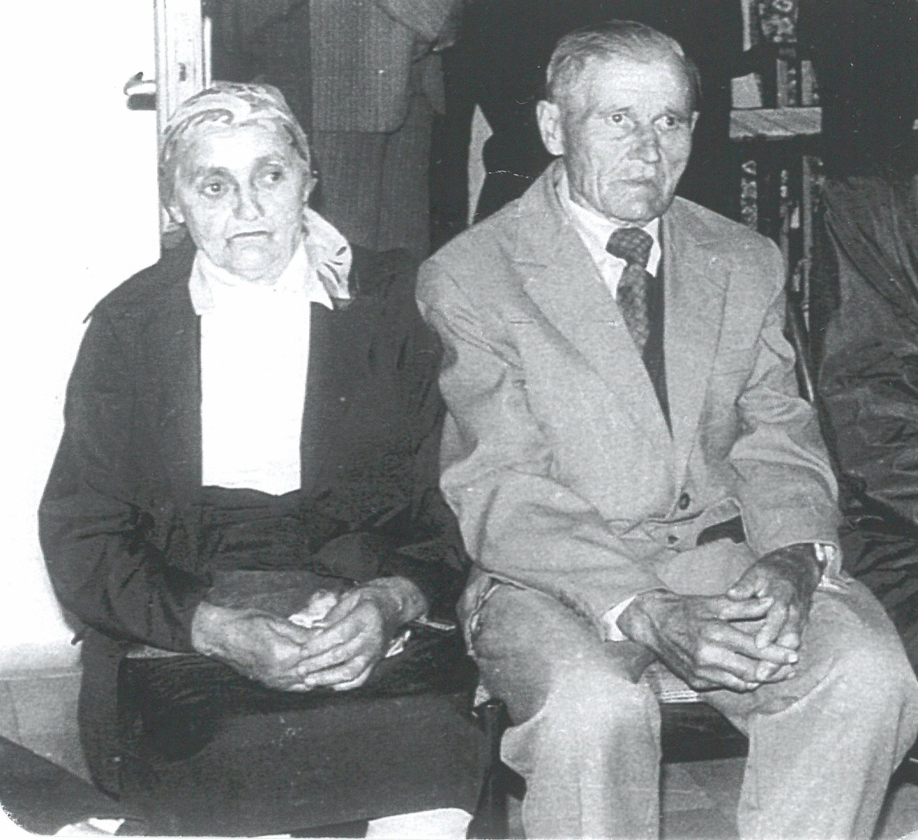
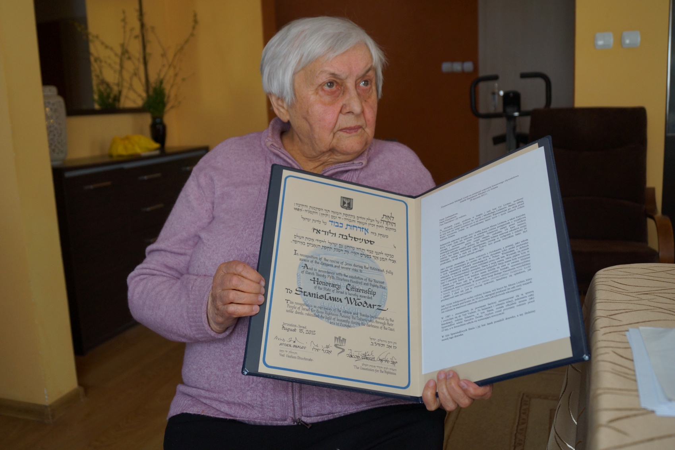
Righteous among the nations
„Whosoever saves a single life, saves an entire universe"
Mishnah, Sanhedrin 4:5
Marianna and Stanisław Szlama, 1978
Stanisława Włodarz neé Szlama, 2016

Slide 7
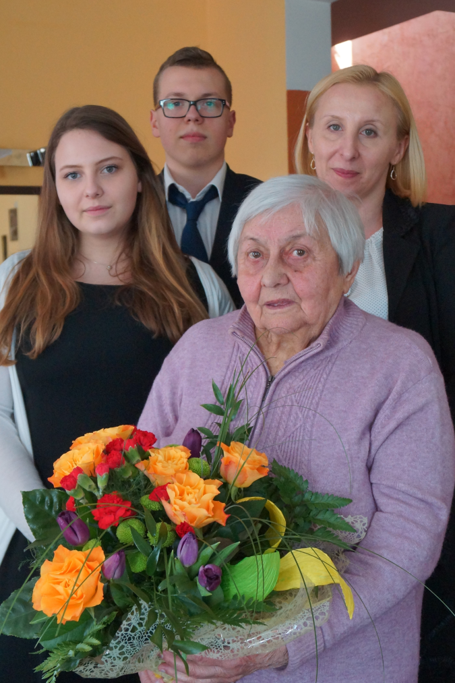
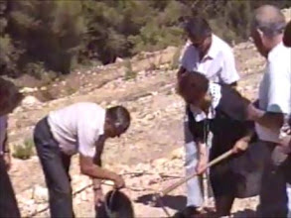
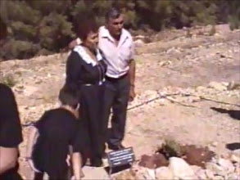
You want me to tell you something about the Jews that stayed at my parents’. I was 12 years old then. The Jews that came to us spoke Polish as they came from Częstochowa and Kocin. I remember that one winter evening, that was Christmas Eve…
Was it here in Jaskrów?
No, it was in Cykarzew. I remember that it was Christmas Eve and I was sitting and my dad came after grooming the horses and he came to my mum and he told her that there were Jews outside and that they were asking if they could possibly get something to eat as they were starving and that they were very cold.
Stanisława Włodarz Szlama with I LO students and teacher
The ceremony of tree planting in Israel, 1989

Slide 8
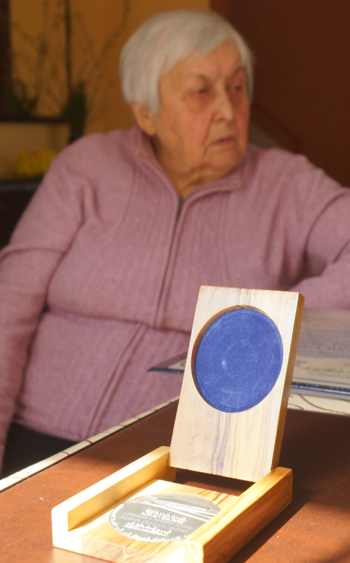
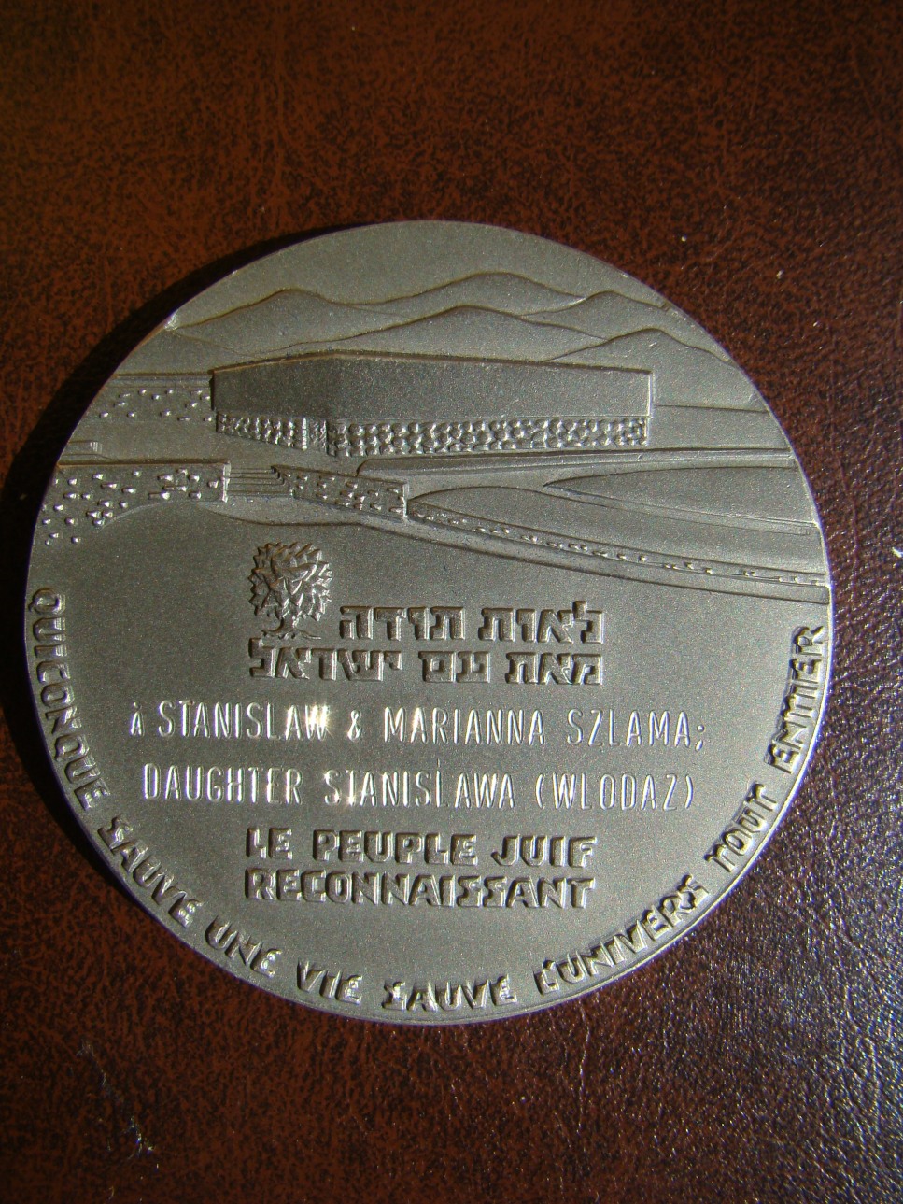
And my mum said „Let them in, let them in!”
Then dad went out and brought them in. I remember one thing. When they entered, they had their hair, beards and moustaches covered in hoar frost . When they entered it got extremely cold in the room. When they both came in, as firstly there were only two of them, they brought this cold inside. Dad locked the door and then my parents gave them food. I don’t know what they talked about. All I know is that my parents decided to put them up. They stayed at our house.

Slide 9
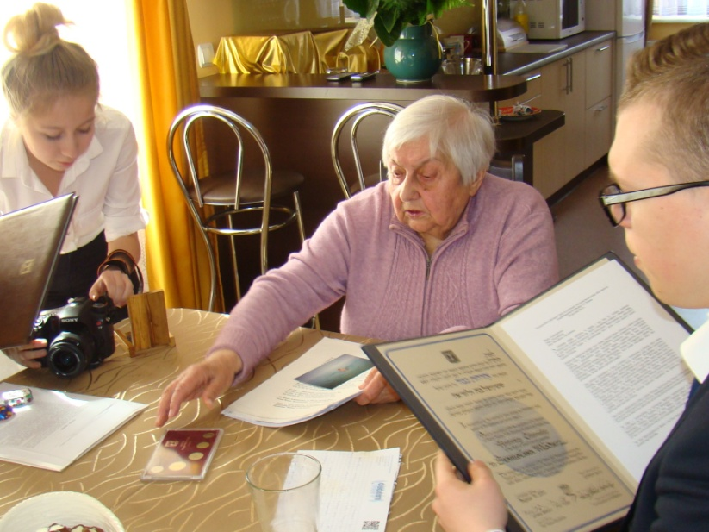
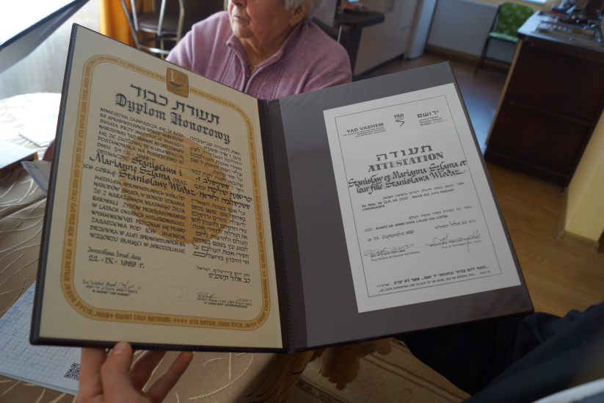
My dad provided them with shelter, food and accommodation. I don’t know how but after some time they brought in two women. They were cousins of one of the men. One man was about 57 years old. The other was about 22. They called him Marian although his real name was Mordechaj. Everybody called the older man „uncle”, although his name was Moshe. All four of them were at my parents’. There were Luba and Shifra.
I’m sure that they spent the first night in the house. They slept on the floor. They stayed with us for quite a long time.

Slide 10
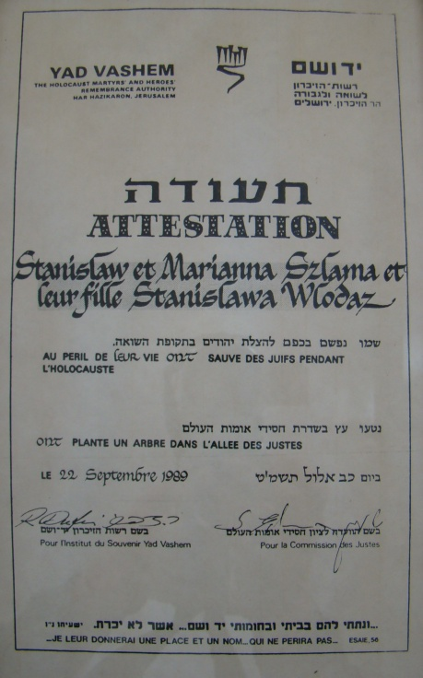
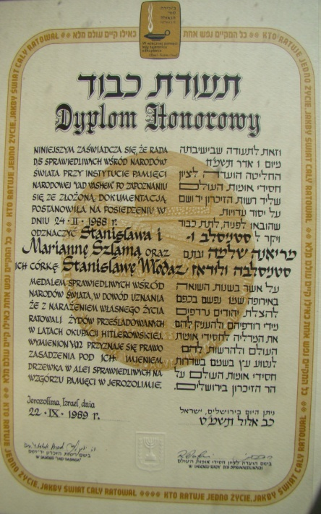
Dad took them to our cellar where we kept potatoes as we had a farm. They sat there on the potatoes. I visited them each time I came from school and I told them about the school, I told them all news. Actually, it was my parents who gave them shelter. I was honoured with the title because it was me who accompanied them and brought news to them. It must have been terrible to sit long hours doing nothing so every day they asked me „Stasia come to us, Stasia come”. And so I did. In the summer they went to our barn, there was a ladder. They climbed it up and sat up there and my mum brought them food.
One more thing. Germans built a bunker in our yard so they had to stay completely quiet. We tried to behave as usual. Dad groomed the horses…

Slide 11
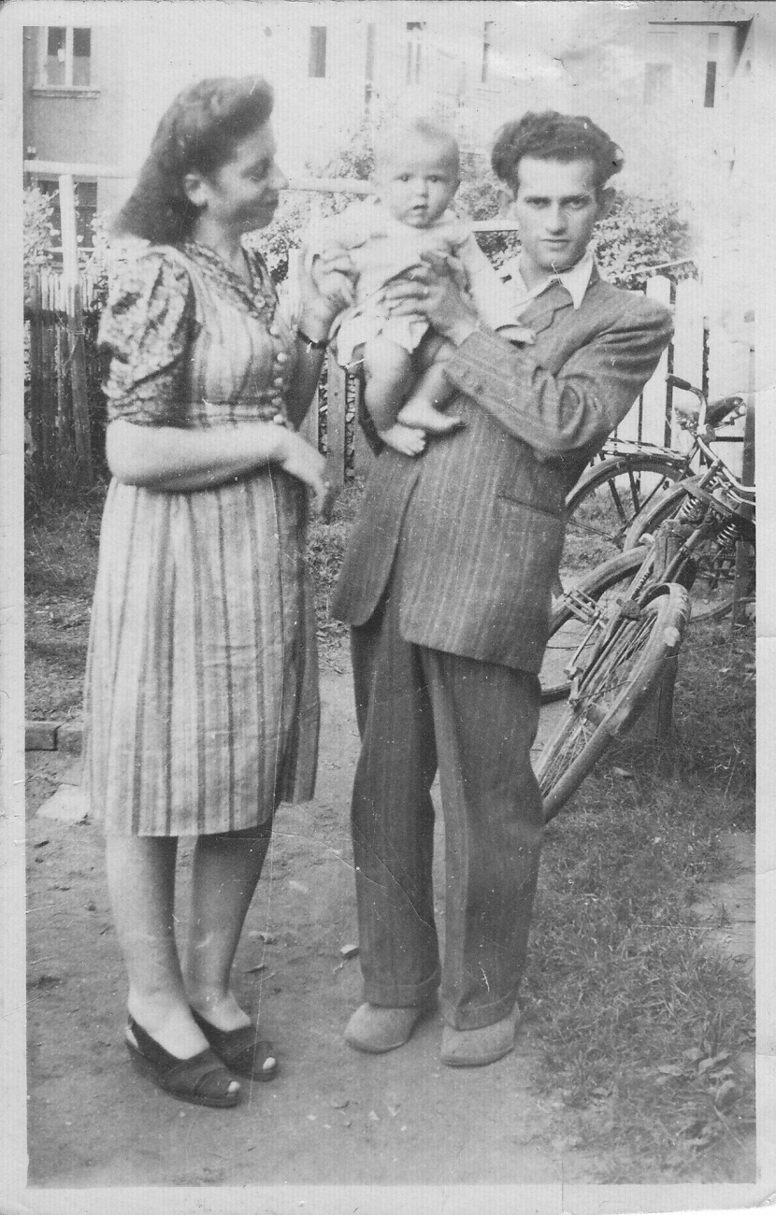
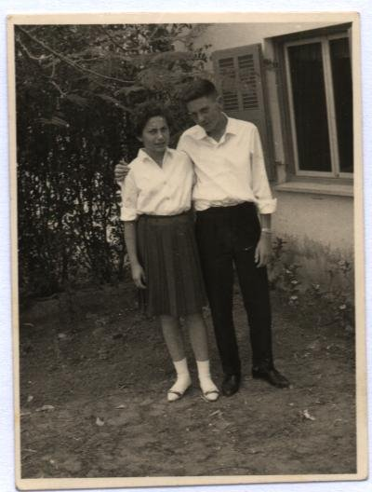
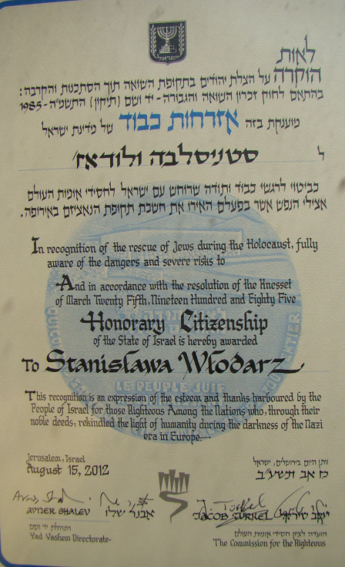
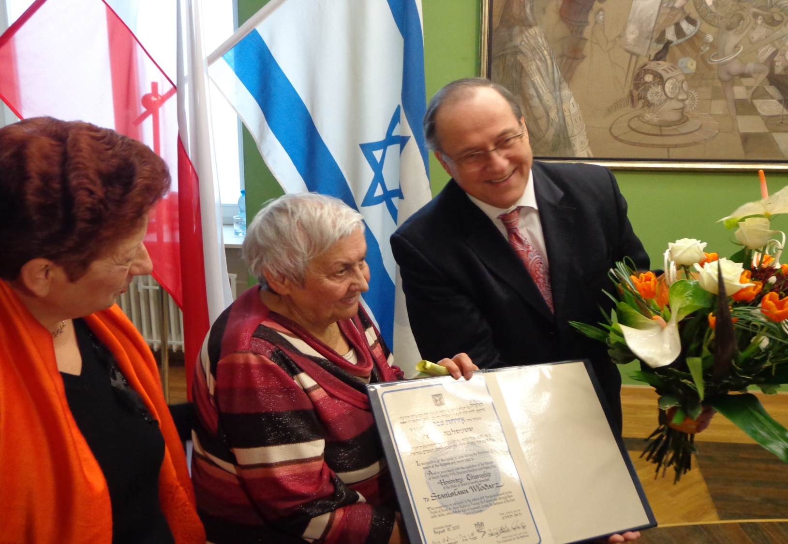
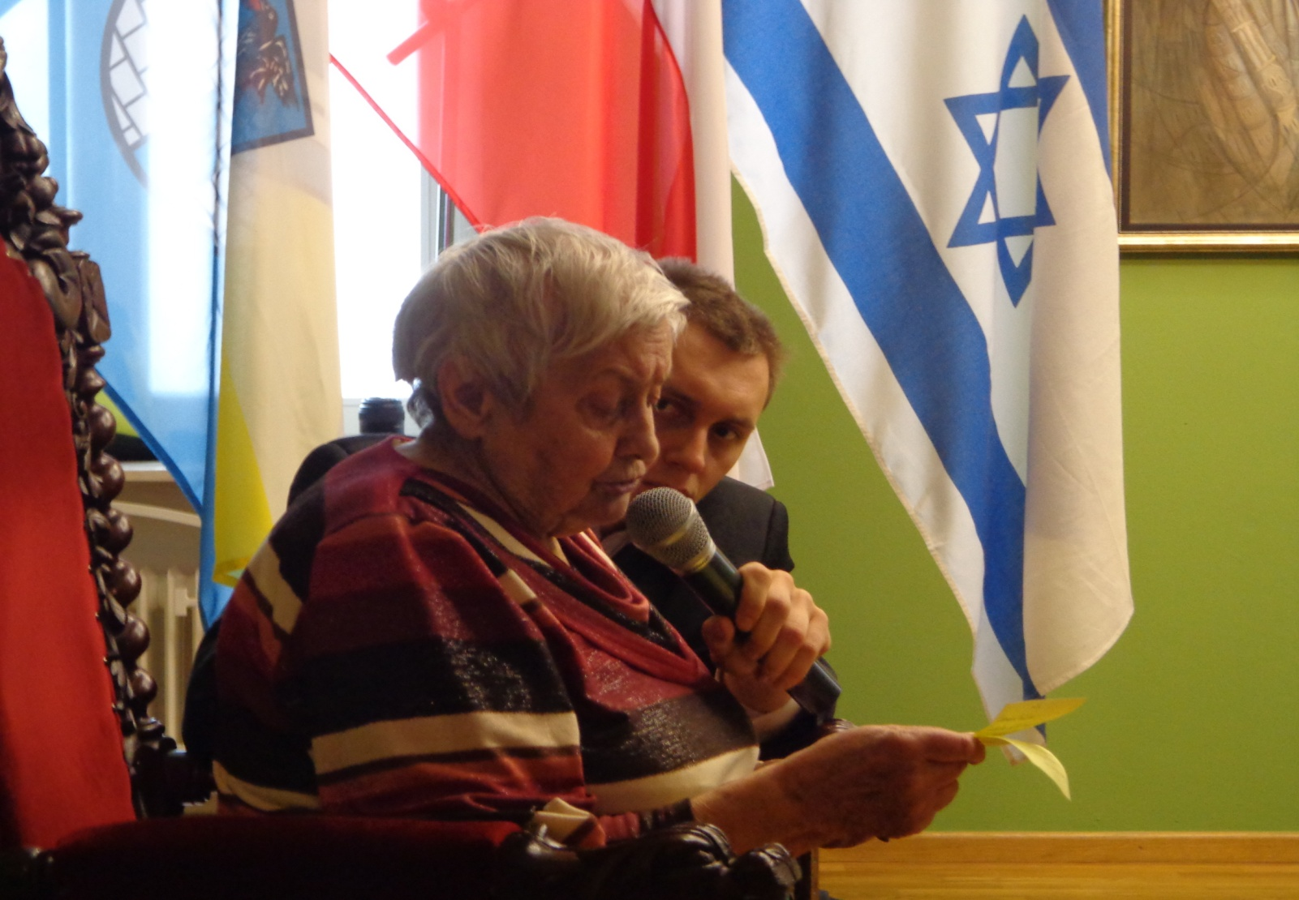
After the war Marian, Luba and Shifra emigrated to Bayreuth in Germany and then to Israel and uncle Moshe Lichter stayed in Poland and got married.
The rescued: Czesława Lichter with her husband Mordechaj
Czesława and Mordechaj’s children
The picture shows Michaela Linial (Mordechaj’s daughter), Stanisława Włodarz (Szlama) and the Ambassador Izrael Zvi Rav-Ner, during the ceremony of awarding Stanisłwa Honorary Citizenship of the State of Israel, 2013 r.

Slide 12
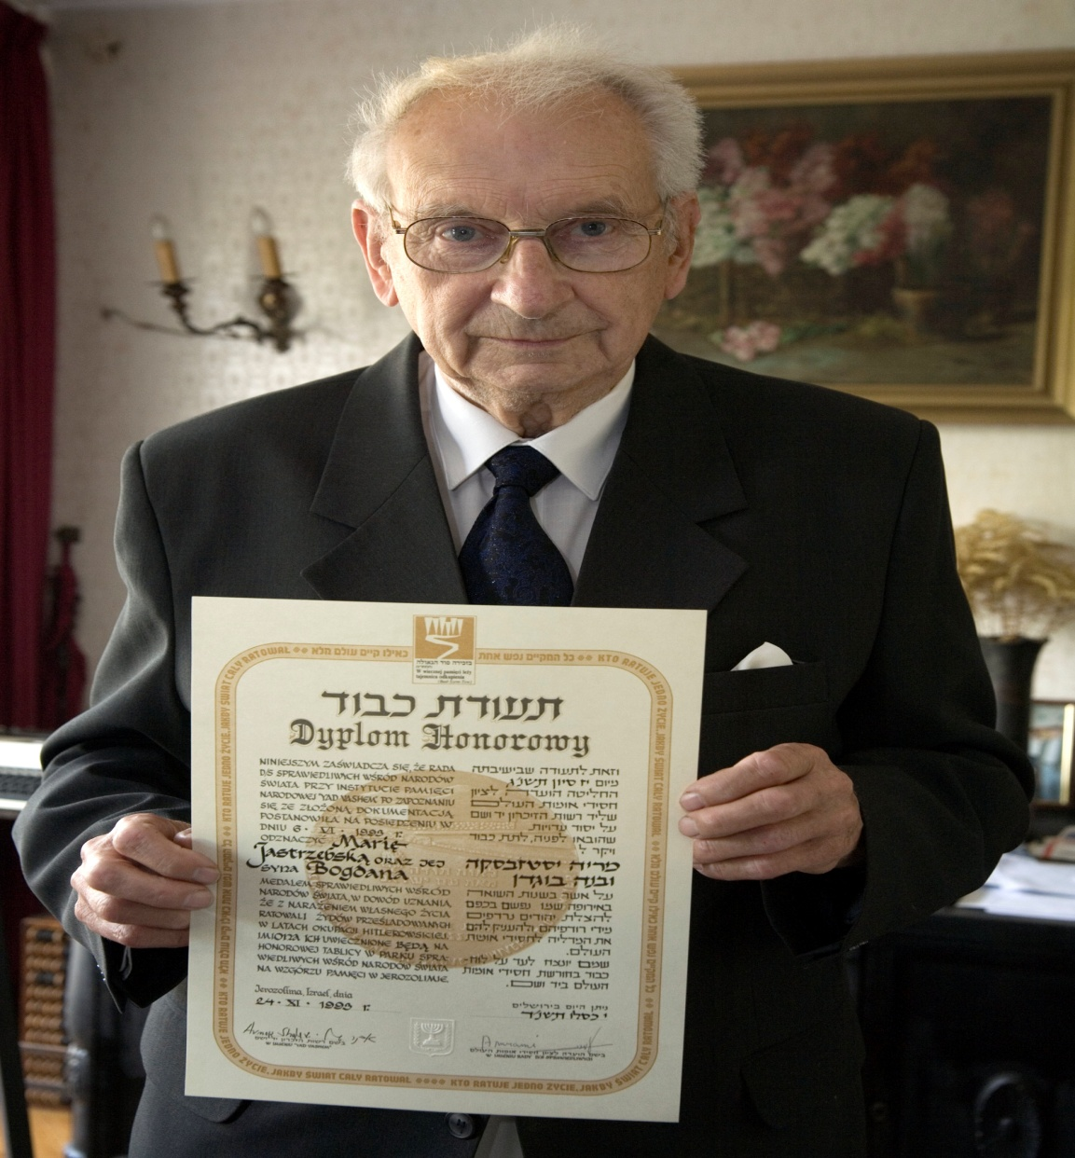
Righteous among the nations
„Whosoever saves a single life, saves an entire universe"
Mishnah, Sanhedrin 4:5
Bogdan Jastrzębski
Maria Jastrzębska

Slide 13
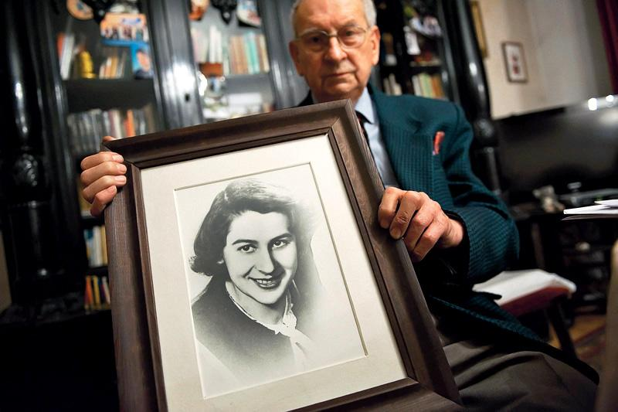
Bogdan Jastrzębski i Krystyna Geisler spotkali się w roku 1940. Byli wówczas nastolatkami. Nawiązała się między nimi przyjaźń. W 1941 Krystyna wraz z ojcem, sędzią Arnoldem Geislerem i jego żoną Zofią – znalazła się w częstochowskim getcie. Bogdan często ich tam odwiedzał. The friendship between Bogdan Jastrzebski and Krystyna Geisler, two youngsters from Czestochowa, began already in 1940, before the
Jews of the town were interned in the local ghetto. Even after that Krystyna’s friend, Bogdan, continued visiting her there, and despite the danger, kept up regular contact with her.

Slide 14
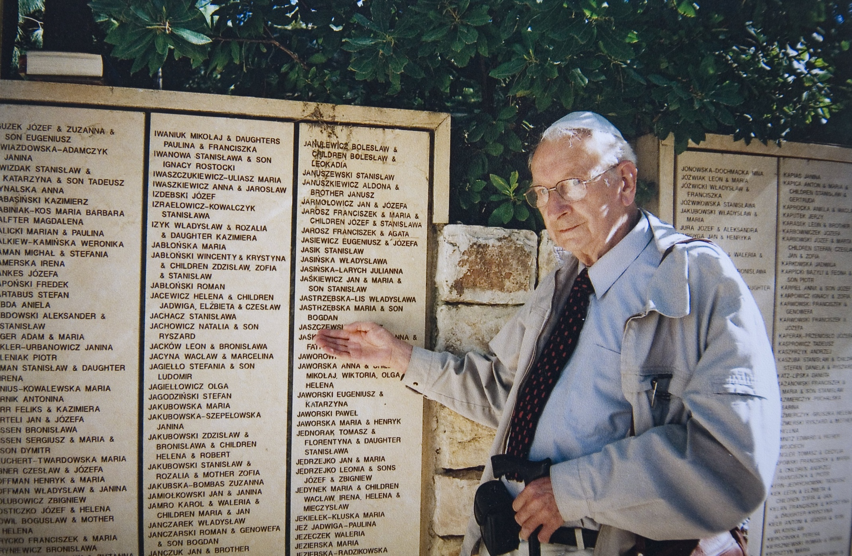
Jesienią 1942 zaczęła się likwidacja getta. Sędzia i jego córka przeżyli, ponieważ oboje przeznaczeni zostali do pracy. Arnoldowi Geislerowi udało się zbiec. Pomocy udzieliła mu rodzina Jastrzębskich. Maria Jastrzębska – matka pana Bogdana – w przebraniu siostry Czerwonego Krzyża przetransportowała go do Warszawy, gdzie ukrywał się aż do wybuchu Powstania.
In autumn 1942, during the liquidation of the ghetto, Krystyna and her father, Arnold Geisler, were deported to a labor camp not far from Czestochowa. Bogdan helped father and daughter escape from the camp and provided Arnold with “Aryan” documents. Bogdan’s mother, Maria, disguised as a Red Cross nurse accompanied Arnold to Warsaw where he survived the war.

Slide 15
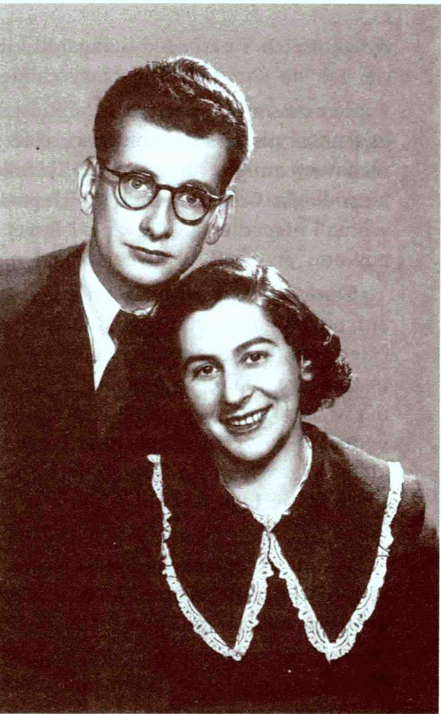
Bogdan porwał Krystynę prosto z kolumny żydowskich dziewcząt pędzonych co rano do pracy, a następnie znalazł dla niej kryjówkę, najpierw w Częstochowie, a później w Warszawie, gdzie niedaleko Grodziska Mazowieckiego z fałszywymi aryjskimi dokumentami pracowała jako opiekunka dzieci aż do wyzwolenia. Krystyna was taken in by Bogdan and his mother, who looked after her devotedly and sent her to stay with friends in Czestochowa at times of particular danger. In the winter of 1943, Bogdan accompanied Krystyna to Warsaw, and obtained “Aryan” documents for her, which enabled her to find work as a nanny near Grodzisk Mazowiecki, a town near Warsaw. She stayed there until the area was liberated in January 1945.

Slide 16
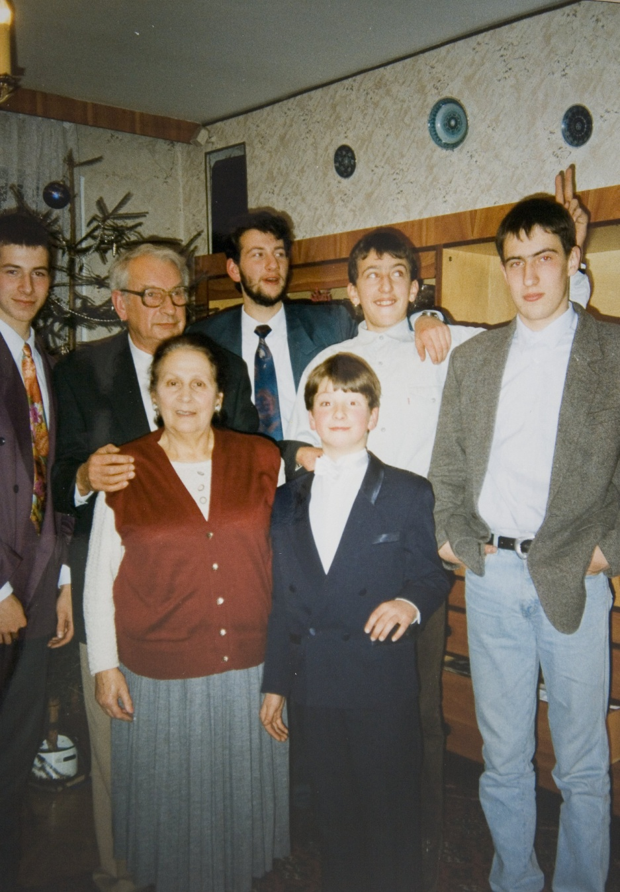
Bogdan with Krystyna and their family
Po wojnie rodzina Geislerów wróciła do Częstochowy. W 1951r. Krystyna i Bogdan pobrali się.
After the war, Bogdan and Krystyna married, and settled in Czestochowa

Slide 17
We would like to express our gratitude to Stanisława Włodarz and her daughter, Barbara as well as Bogdan Jastrzębski
The presentation was made by Agnieszka Mrowiec Smaga and is based on the work of the following Juliusz Słowacki High School students:
Klaudia Pustuł, Julia Kuraś, Łukasz Piotrowski, Weronika Błachowicz, Marcin Basiński and Pola Mielczarek with the help of Małgorzata Kaim
Bibliography:
www.sprawiedliwi.org.pl
www.yadvashem.org
private photo archives

